Slide 1
Measuring KSK Roll Readiness
Geoff Huston
APNIC Labs

Slide 2
Measurement Objective
What number of users are at risk of being impacted by the KSK Roll?
  There are two risk elements for resolvers:
    Unable to receive a 1,414 octet UDP response from the root servers (query for DNSKEY RR from the root zone)
    Failure to follow RFC5011 key introduction procedure
  In either case the resolver outcome is the same: Not loading the incoming trust key into the local trusted key store
  And if the user passes queries only to these affected resolvers than the roll will cause a loss of DNS service

Slide 3
Measuring Resolvers
Getting resolvers to report on their local trusted key state
  Resolvers that support the RFC8145 signal mechanism periodically include the key tag of their locally trusted keys into a query directed towards the root servers
  But:
    The signal is only visible to root servers
    DNS forwarders confuse the attribution of the signal
    And the number of users that rely on reporting resolvers is not apparent
    And it is unclear whether the user has alternate resolvers that they can use

Slide 4
User-Visible Resolver Measurement
Can we devise a DNS query that could reveal the state of the trusted keys of the resolvers back to the user?
  Not within the current parameters of DNSSEC and/or resolver behaviour
  But what if we could change resolver behaviour?
    Just as RFC8145 required a change in resolver behaviour
  What about a change to the resolver’s reporting of validation outcome depending on the resolver’s local trusted key state?
    If a query contains the label “_is-ta-<key-tag>” then a validating resolver will report validation failure if the key is NOT in the local trusted key store
    If a query contains the label “_not-ta-<key-tag>” then a validating resolver will report validation failure if the key IS in the local trusted key store

Slide 5
User-Visible Resolver Measurement
Three DNS queries:
  _is-ta-4066.<some.signed.domain>
  _not-ta-4066.<some.signed.domain>
  <badly-signed>.<some.signed.domain>
Single Resolver Analysis:
Resolver Type
Loaded New KSK
NOT loaded New KSK
Mechanism not supported
Not validating
Query 1 Query 2 Query 3
A SERVFAIL SERVFAIL
SERVFAIL A SERVFAIL
A A SERVFAIL
A A A

Slide 6
User-Visible Resolver Measurement
Multiple Resolver Analysis
  A SERVFAIL response will cause the use to repeat they query to other configured resolvers. In a multi-resolver scenario, and where forwarders are used we can still determine if the user will be impacted by the KSK roll
User Impact
OK
NOT OK
UNKNOWN
NOT Impacted
Query 1 Query 2 Query 3
A SERVFAIL SERVFAIL
SERVFAIL A SERVFAIL
A A SERVFAIL
SERVFAIL SERVFAIL SERVFAIL
A A A

Slide 7
Measuring User Impact
Create these tests in a scripted web page and allow users to test the state of their resolvers
Load these tests into an online ad campaign and use the ad to pass the test to millions of users
  If the user can resolve Query 1, and SERVFAILs on Query 2 and Query 3 then the user is able to validate using the nominated key as a trusted key
  If the user SERVFAILS on Query 1, resolves Query 2 and SERVFAILs on Query 3 then the user is unable to validate using the nominated key as a trusted keys
  Otherwise if the user SERVFAILS on Query 3 then the result is indeterminate

Slide 8
Privacy and Security Considerations
This test itself does not reveal which resolvers are used by end users in resolving names
The query itself need not contain any end user identifying material
The methodology never changes “insecure” to ”authenticated” – it will only change “authenticated” to “insecure” depending on the resolver’s local trusted key state when resolving certain labels
Anyone can set up a test condition within their delegated part of the DNS
The results of the test are passed back only to the user in the form of a resolution outcome

Slide 9
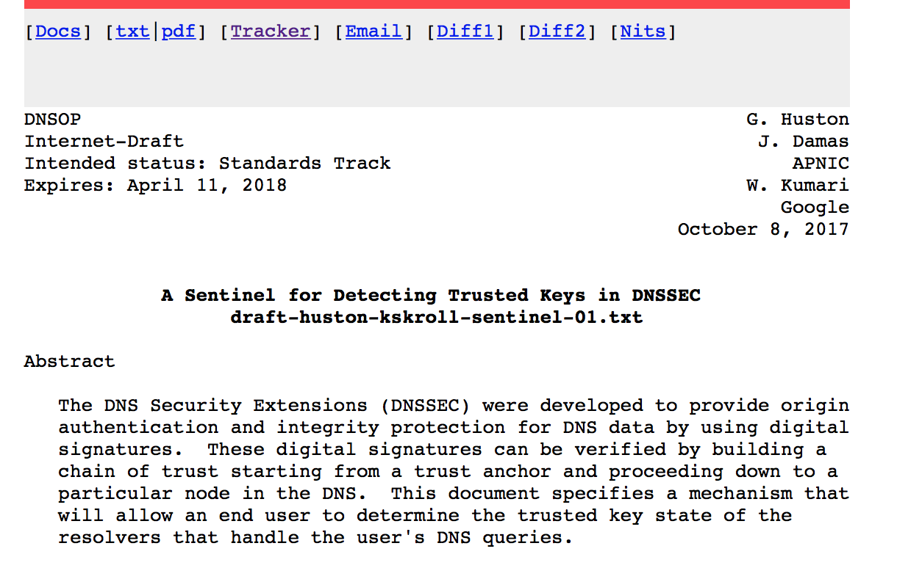
Internet Draft
draft-huston-kskroll-sentinel

