Slide 1
Where are we with Securing Addressing and Routing?
Geoff Huston
Chief Scientist, APNIC
1 September 2015

Slide 2
On the Internet…

Slide 3

…there are many ways to be bad!

Slide 4
An Ascending Scale of Badness
Port Scan for known exploits
  General annoyance
Spew spam
  Yes, there are still gullible folk out there!
Cryptolocker extortion
  And enter a world of petty and not so petty crime
Enlist a bot army and mount multi-gigabit DOS attacks
  Extortion leverage and general mayhem
Mount a routing attack
  And bring down an entire region / country / global network!

Slide 5

If I were really bad (and evil)…
I’d attack routing.

Slide 6
If I were really bad (and evil)…
Through routing I’d attack:
  isolate critical public servers and resources
  overwhelm the routing system with spurious information
And bring selected parts of the network to a complete chaotic halt!

Slide 7
How many advertisements in today’s BGP are “lies”?
We’ve all heard of the “YouTube” route hijack, and similar incidents of injecting false information into the routing system.
But the situation is a little more mundane than a few isolated high profile incidents - who uses addresses and AS numbers that are not registered as “in use” in our Internet number registry system?

Slide 8
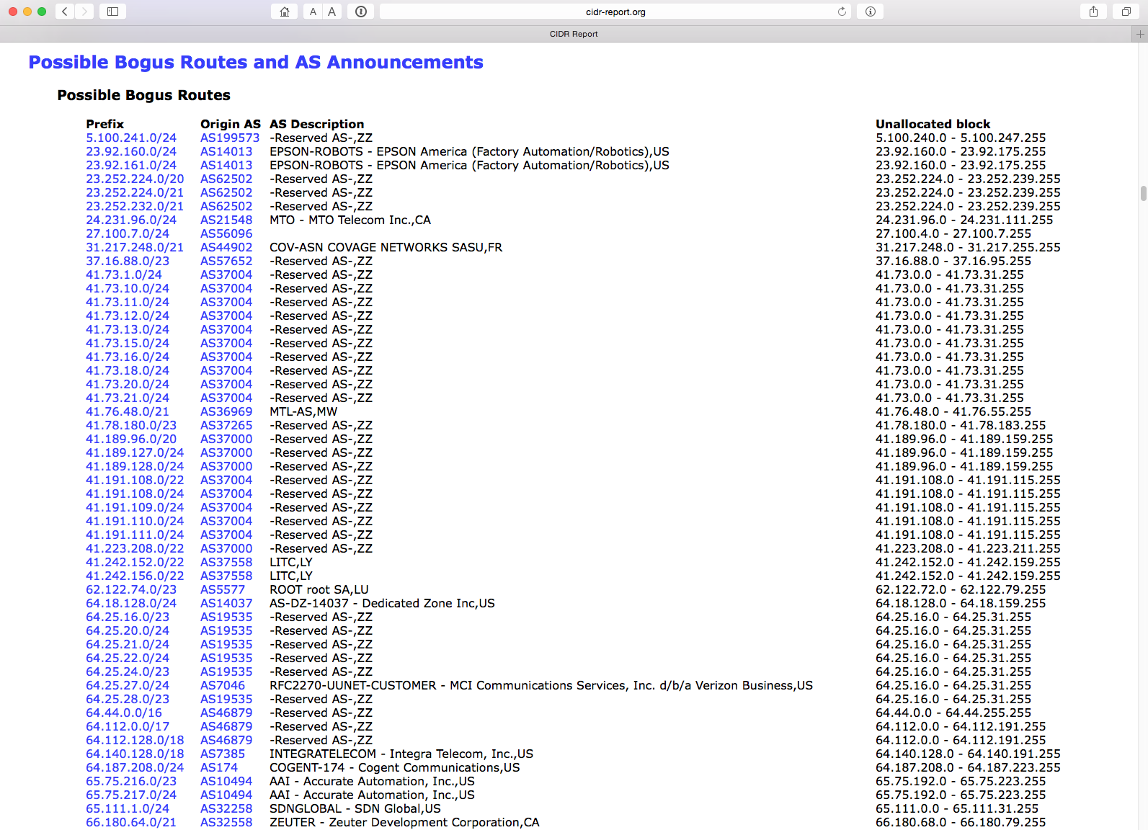
www.cidr-report.org

Slide 9
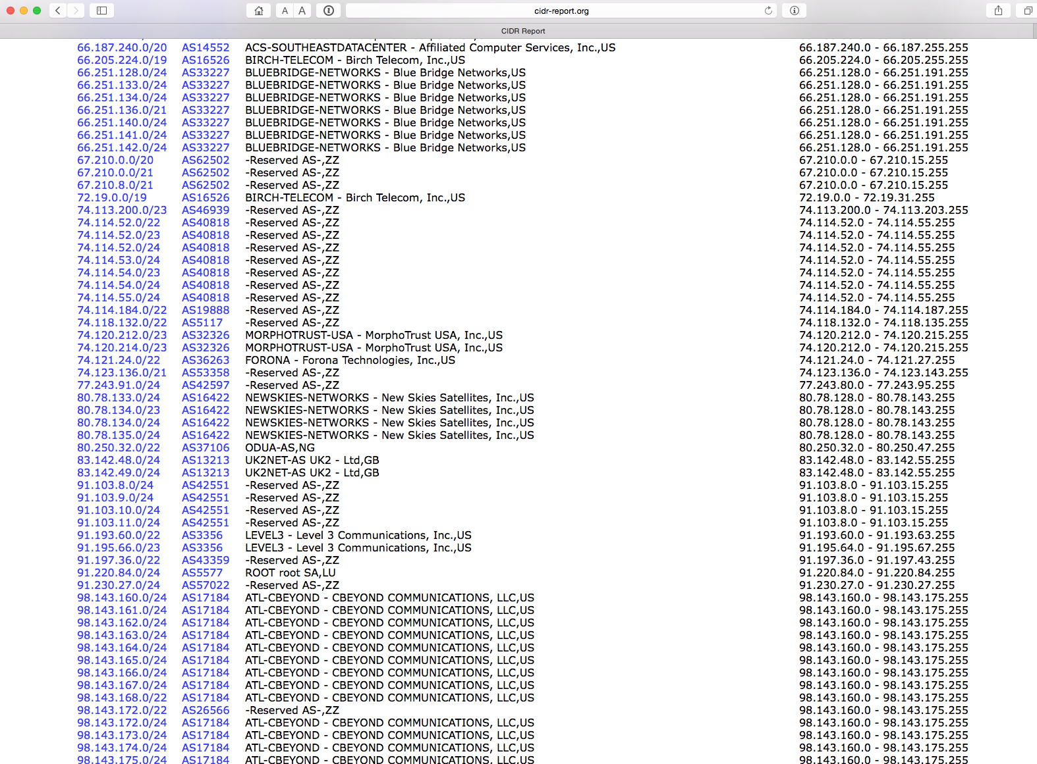
and…

Slide 10
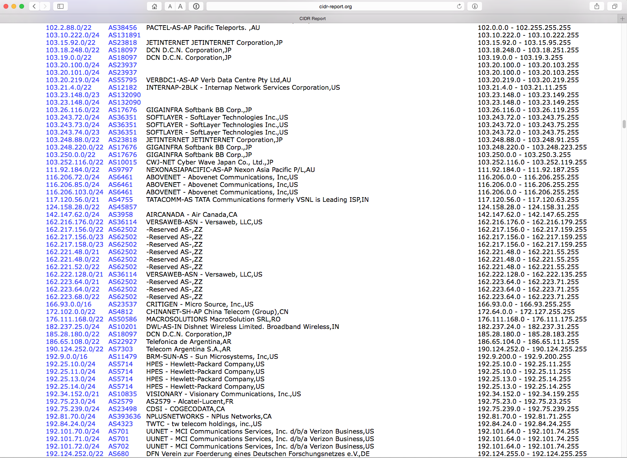
plus…

Slide 11
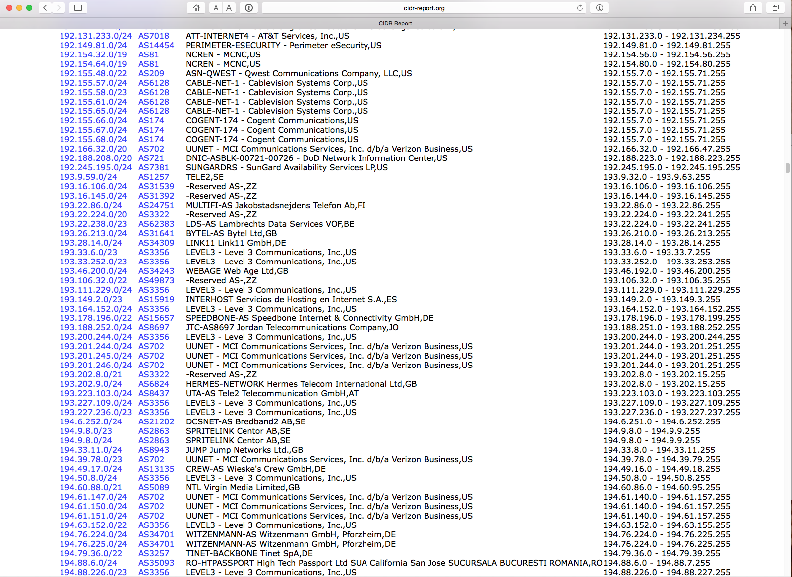
yes, there’s more

Slide 12
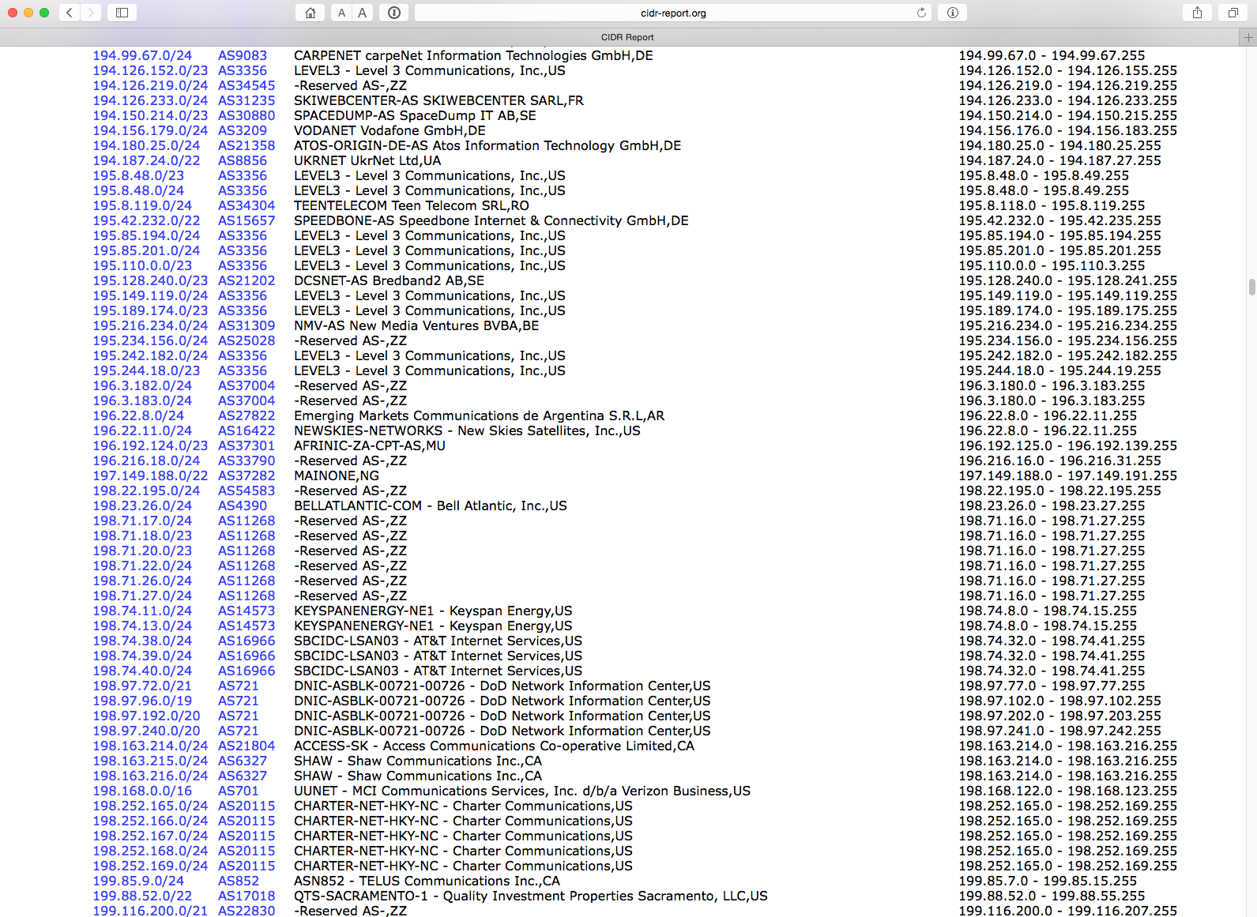
getting the point yet?

Slide 13
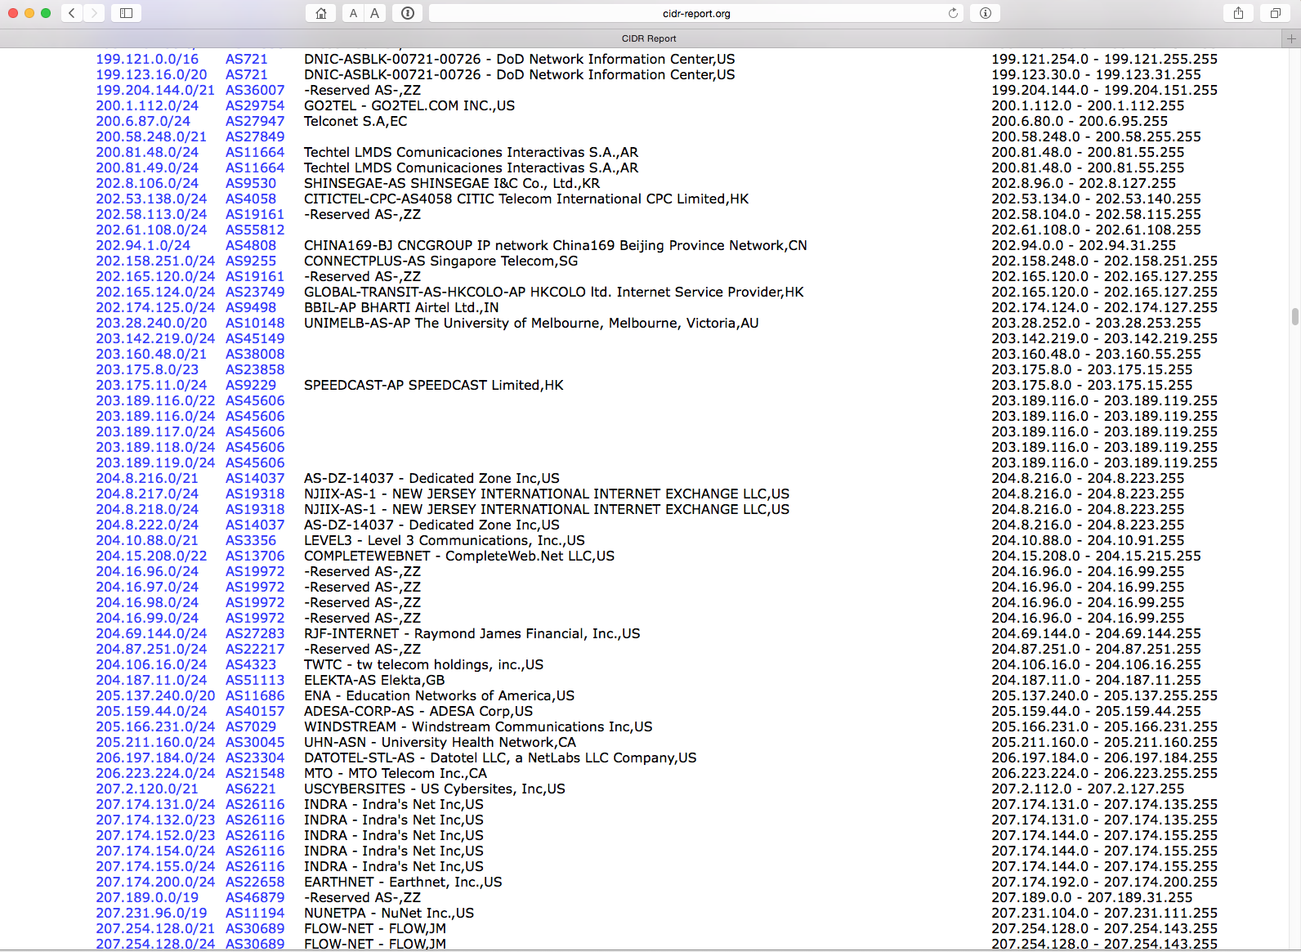
still more!

Slide 14
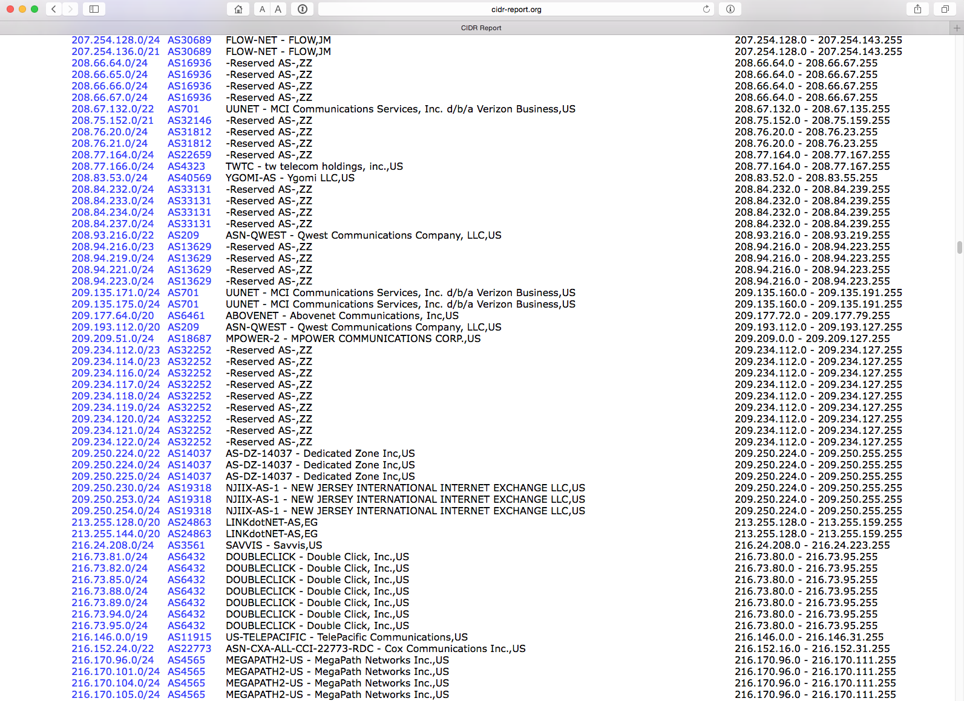
wake me up when we’re done

Slide 15
zzzzzzz

Slide 16
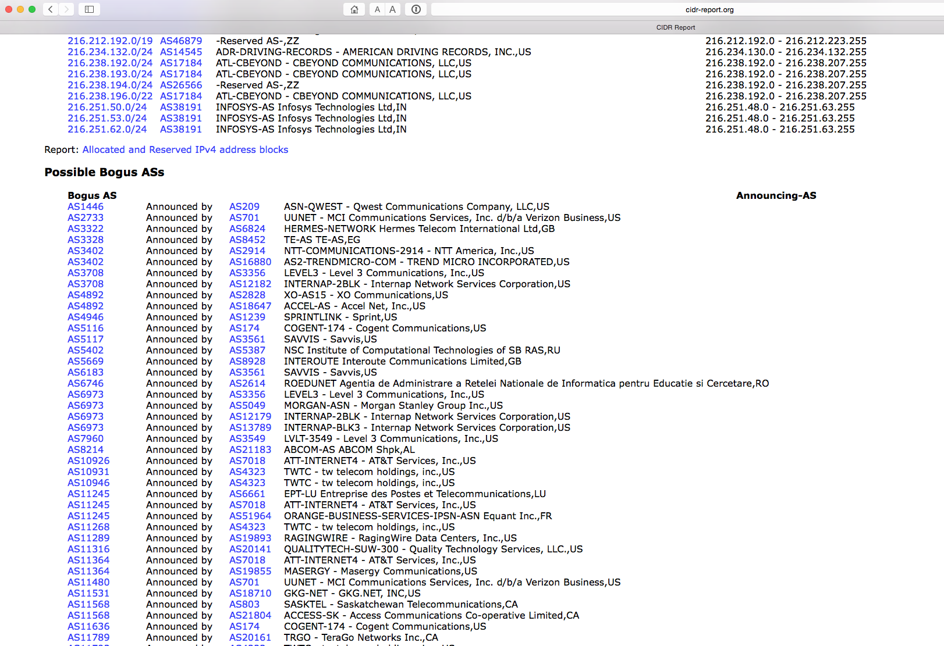
zzzzzzz

Slide 17
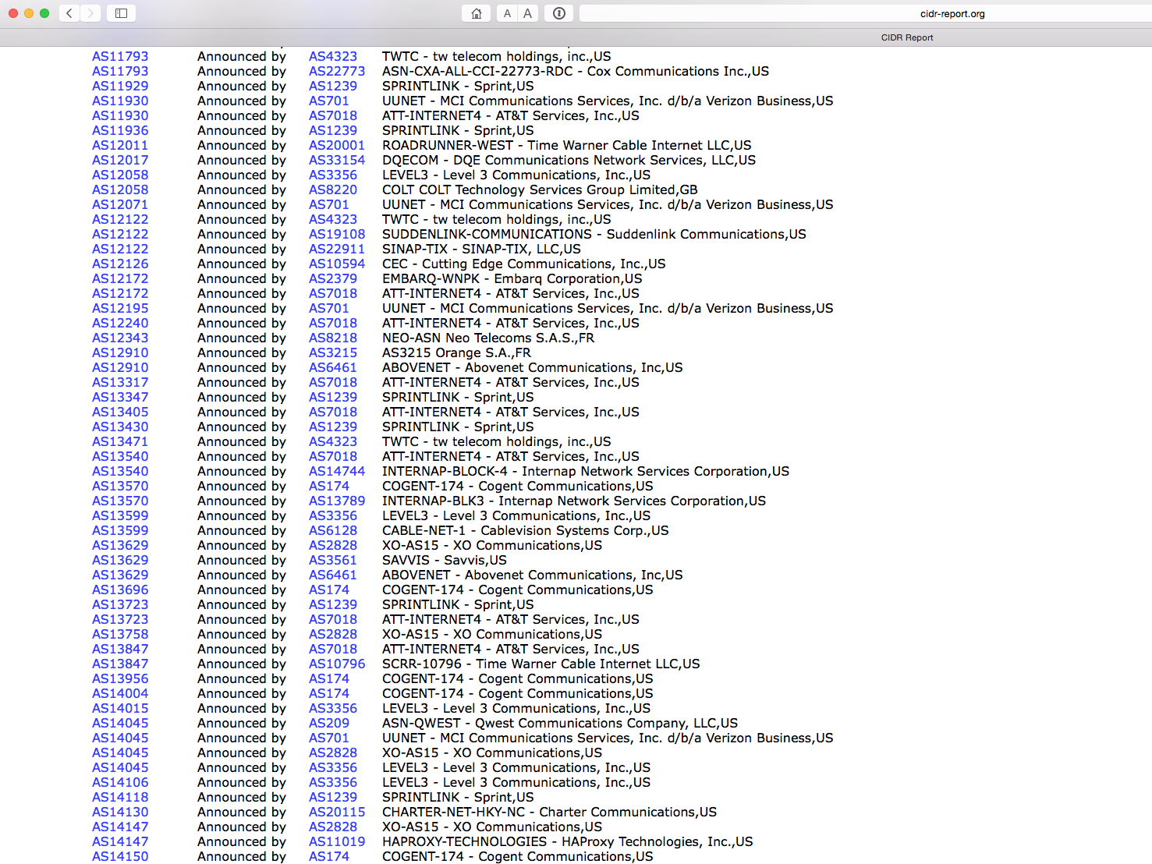
zzzzzzz

Slide 18
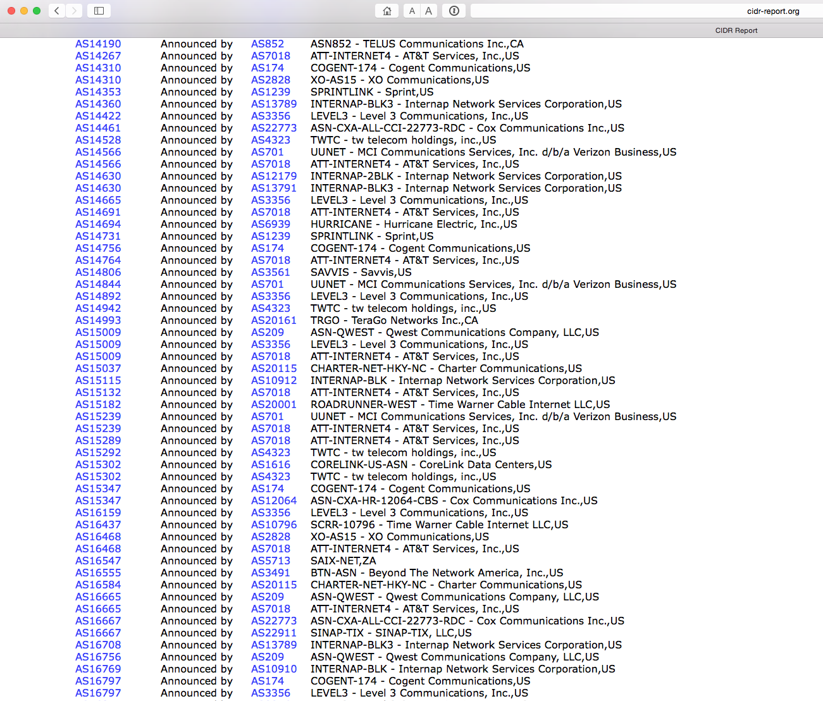
zzzzzzz

Slide 19
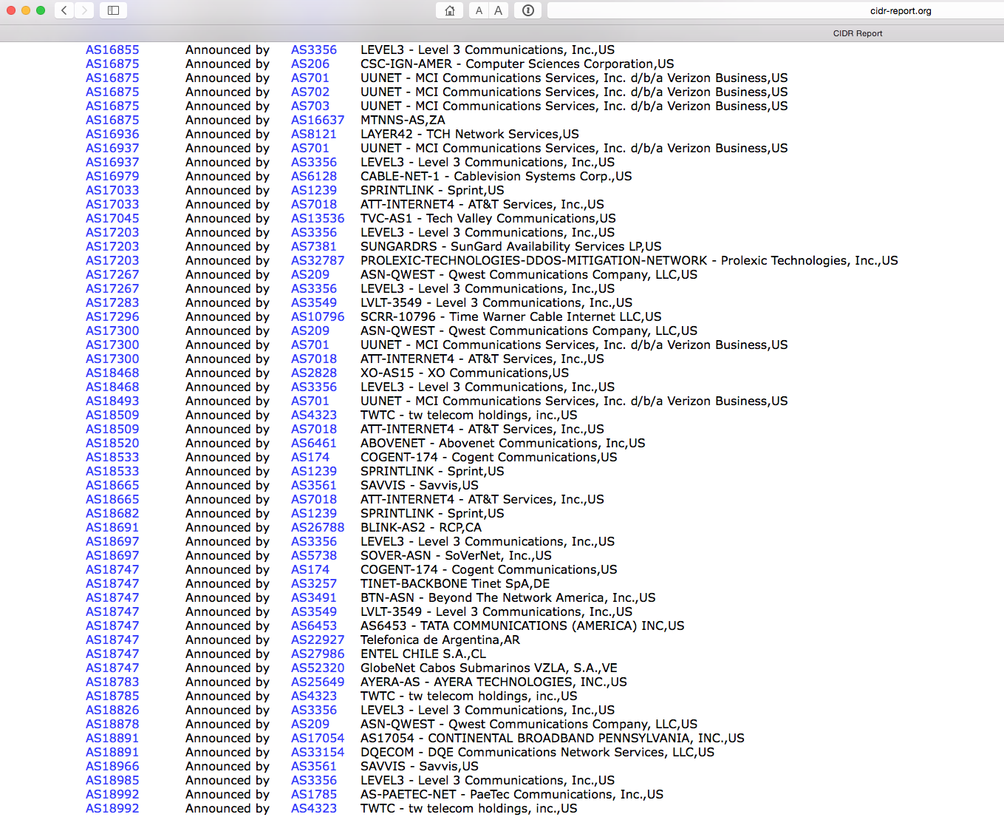
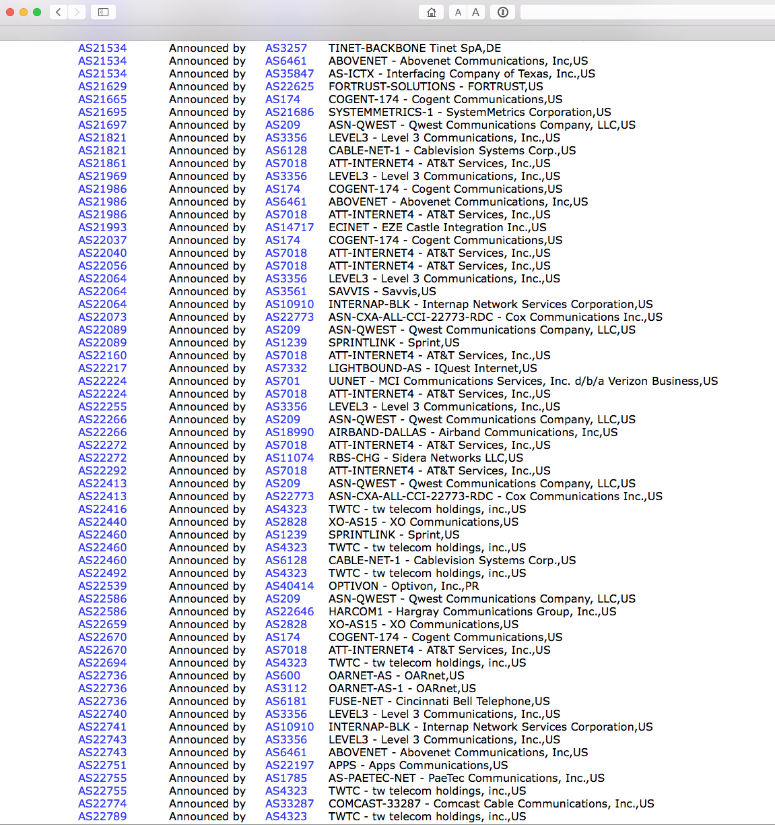
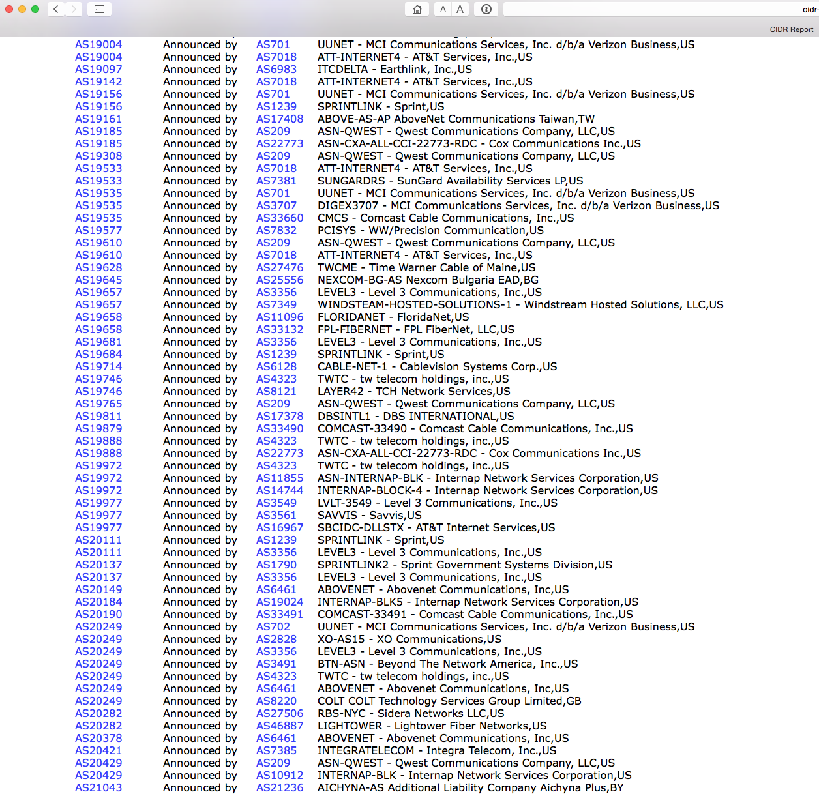
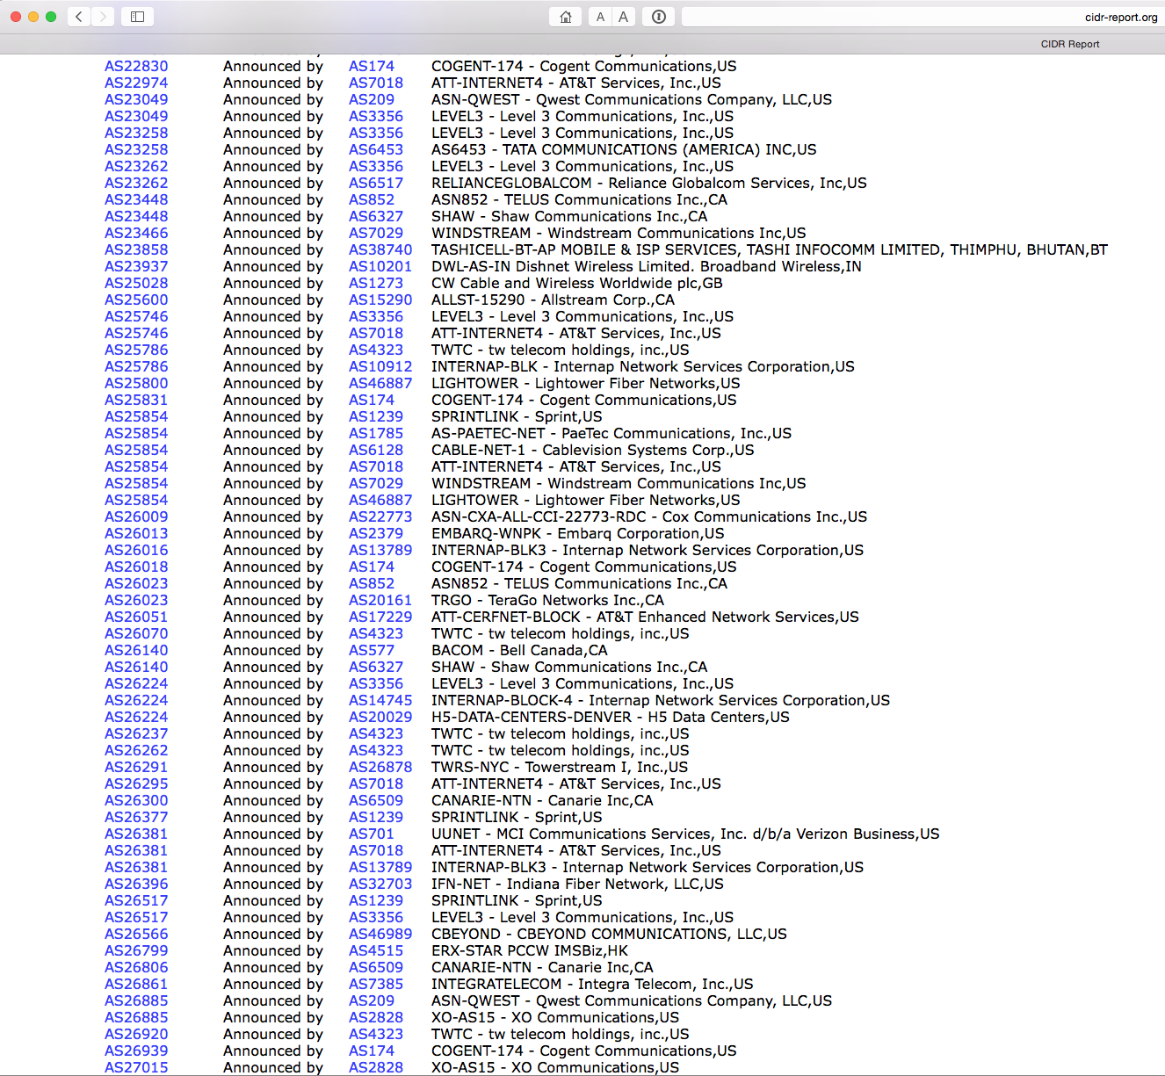
let’s speed this up…

Slide 20
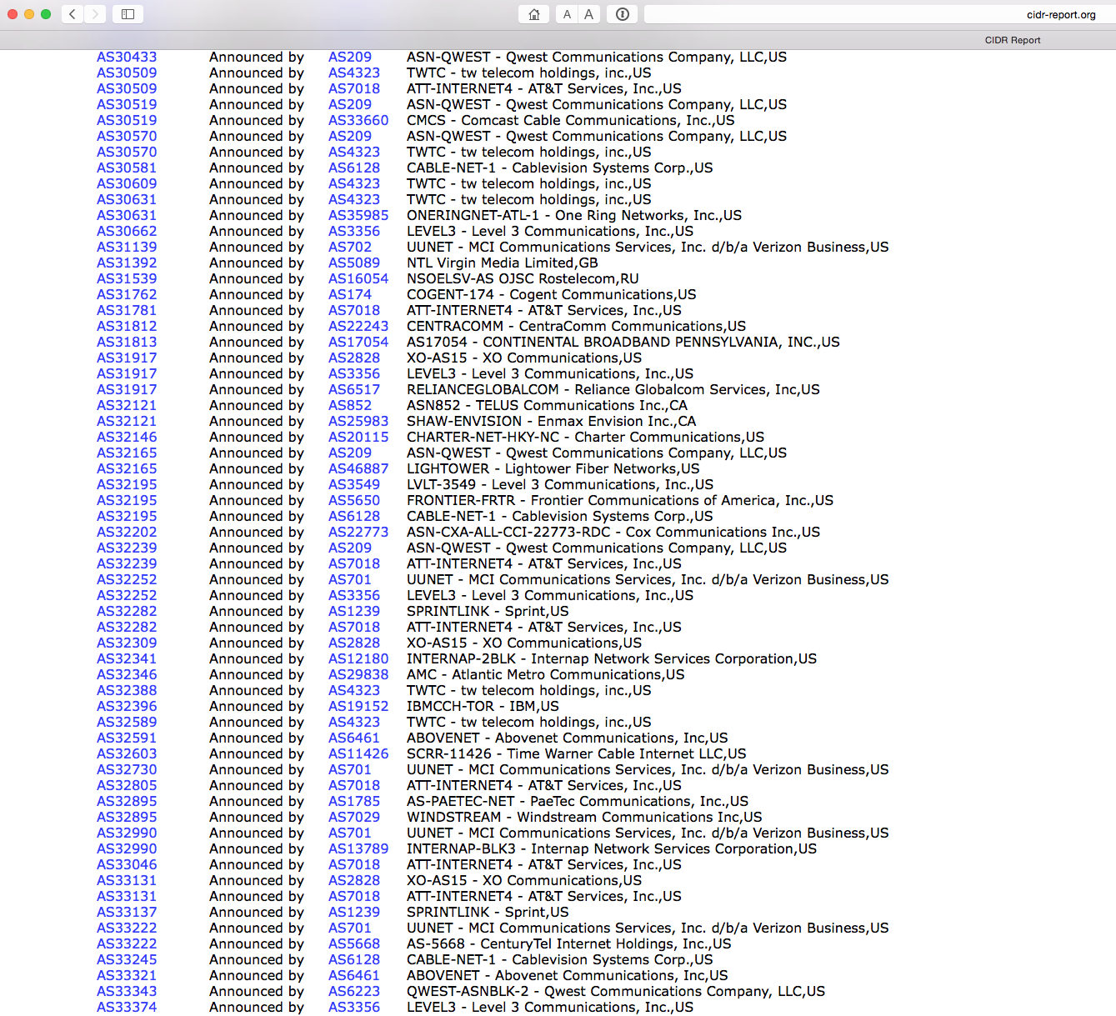
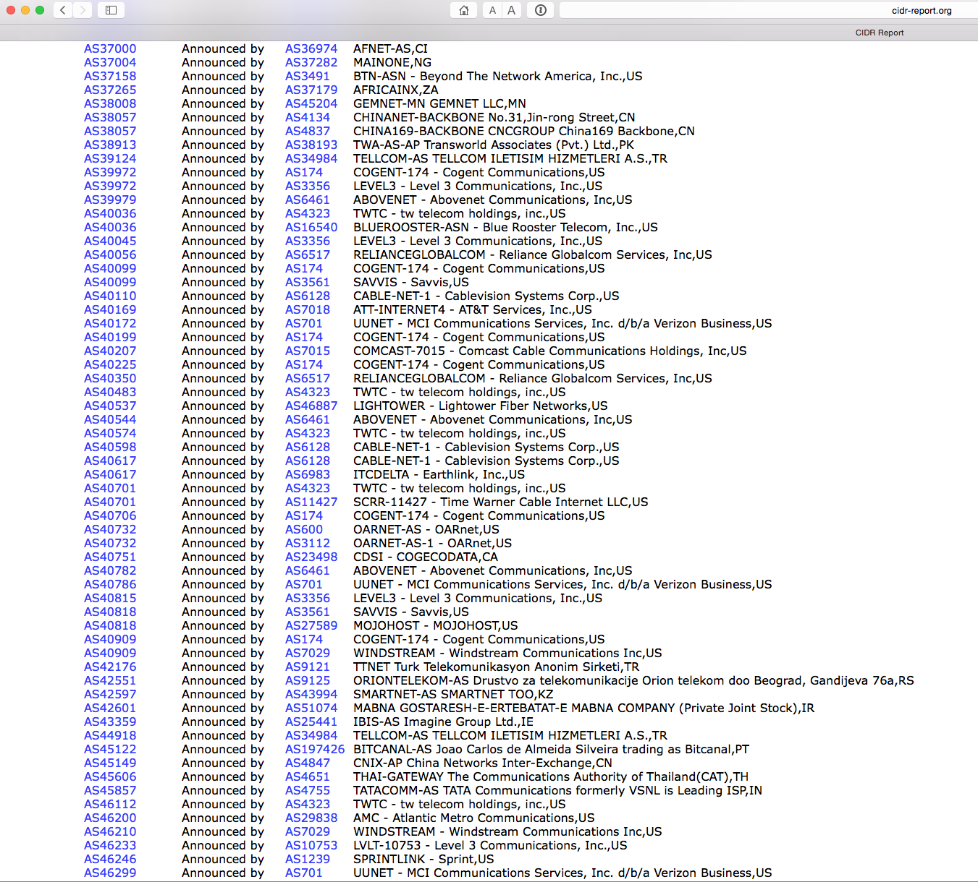
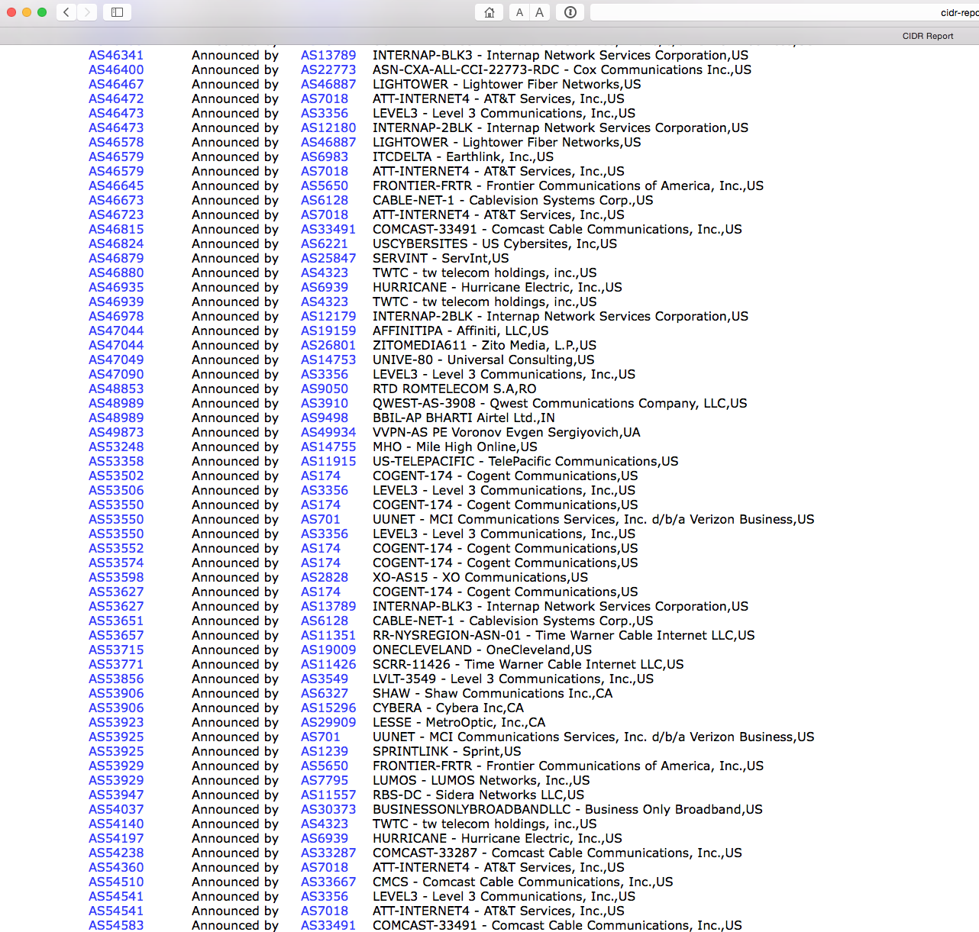
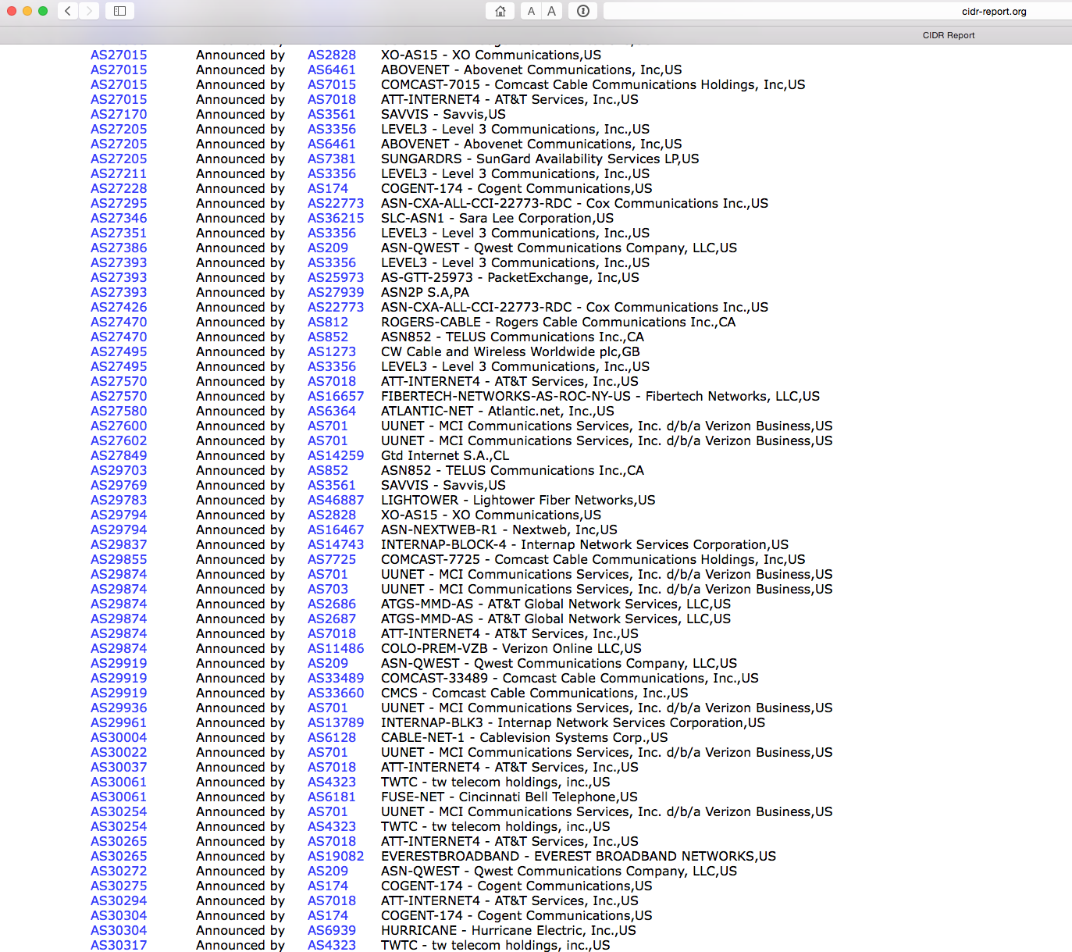
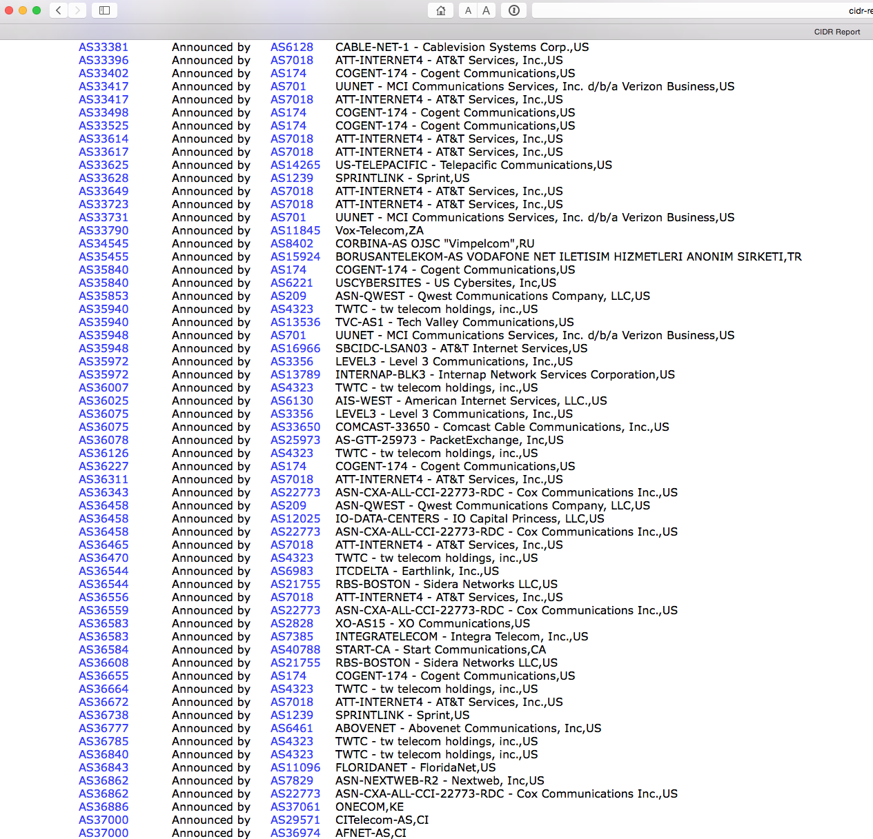
don’t forget: ALL of these advertised addresses and ASes are bogus!

Slide 21
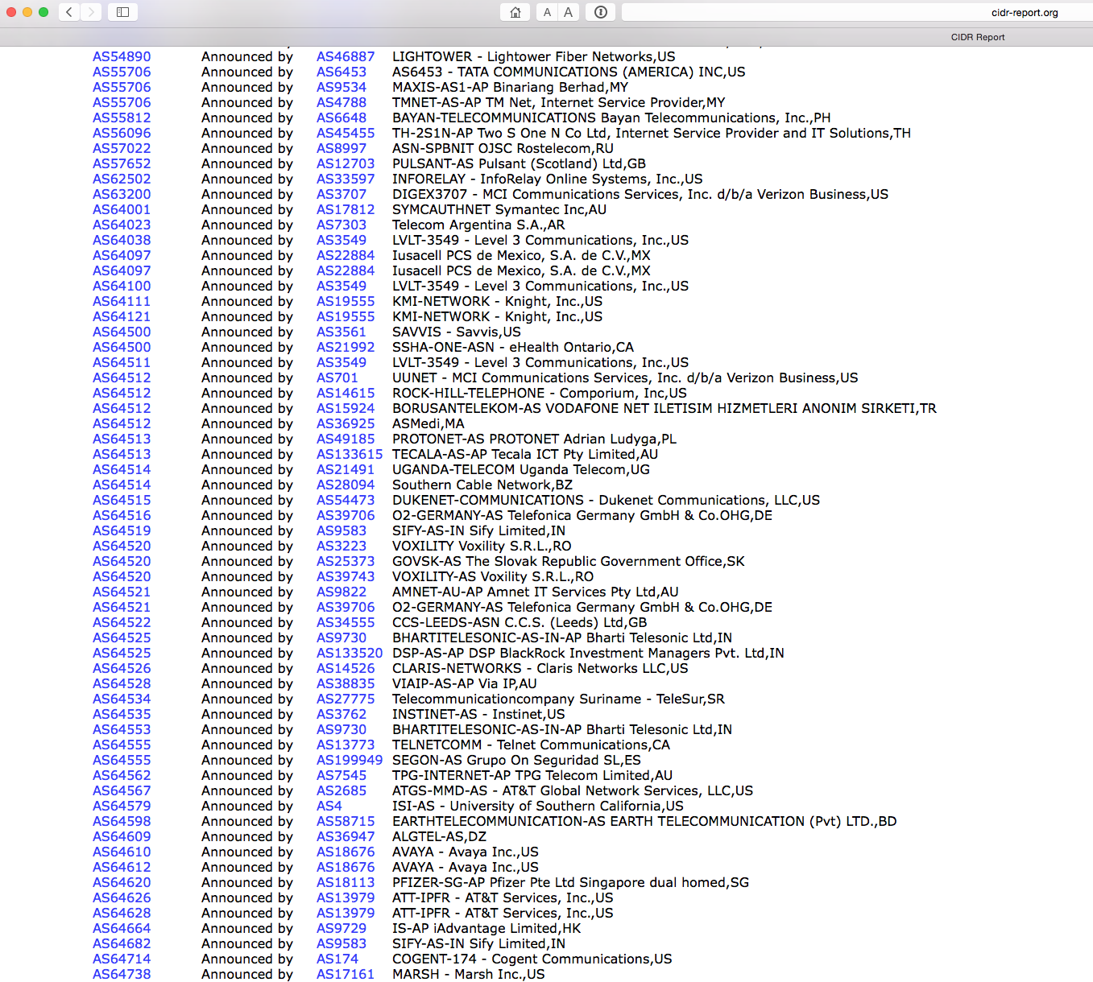
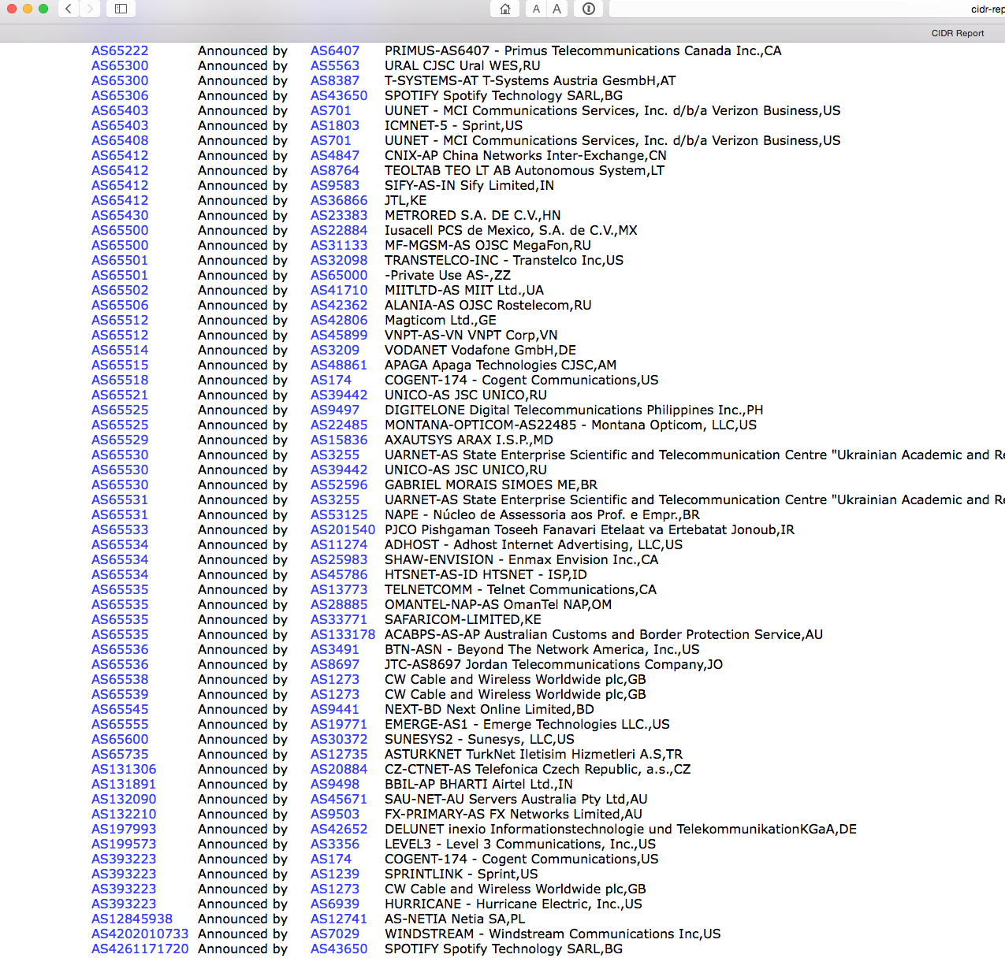
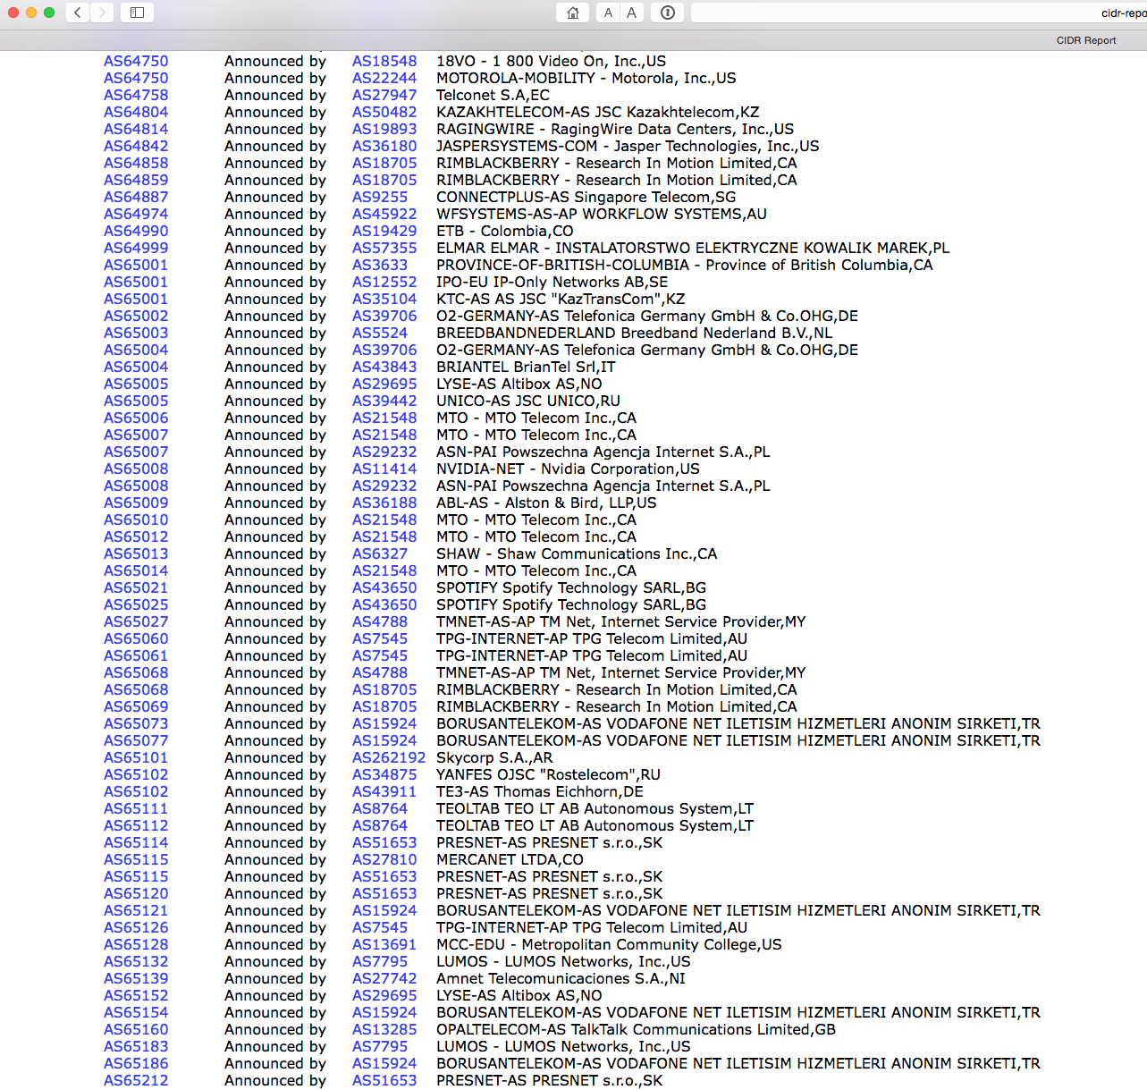
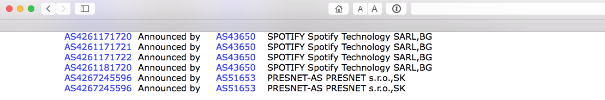
almost done…

Slide 22
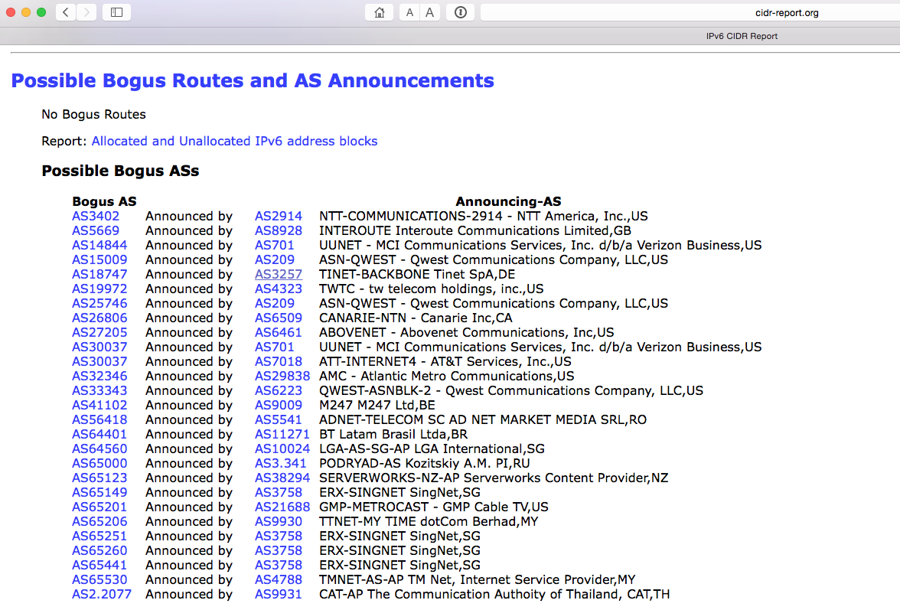
and lets not forget IPv6!

Slide 23
What’s the base problem here?

Slide 24
What’s the base problem here?
We really are not doing a very good job!

Slide 25
Why?
The Internet uses a decentralised and distributed model of control in many aspects of its operation
Routing is perhaps the best example:
  There is no point of “authority”
  There is no arbitrator or referee, and no reference source of information
  Everyone is trusted by everyone else to act correctly and honestly
  And not everyone has the same set of motives to act honestly and with good intent all the time
  And not all software and hardware is perfect all of the time

Slide 26
What’s the base problem here?
Routing is built on vague mutual trust models
Routing auditing is a low value activity that noone really performs with any level of thoroughness
  And no matter how good a job you may do, that does not mean everyone else shares your enthusiasm and zeal to police the routing system
We have grown used to lousy solutions and institutionalized lying in the routing system, and accept that as “normal”
And because instances of abuse are supposedly relatively infrequent we are prepared to tolerate the risks with having a completely insecure routing system

Slide 27
What’s the base problem here?
Noone is sufficiently motivated to care enough about the integrity of the network to address routing integrity!
And we all need to act to be effective!

Slide 28
Routing Security is a shared problem
It’s a tragedy of the commons situation
  Nobody can single-handedly apply rigorous tests on the routing system
  And the lowest common denominator approach is to apply no integrity tests at all
  It’s all misplaced trust and absolutely no effective defence!

Slide 29
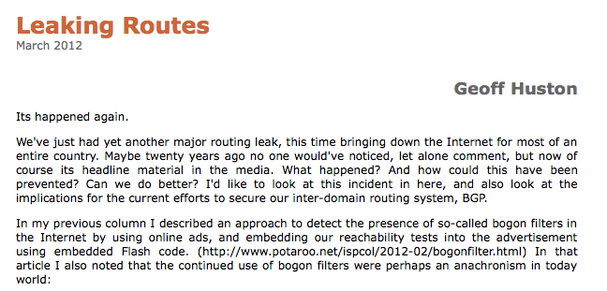
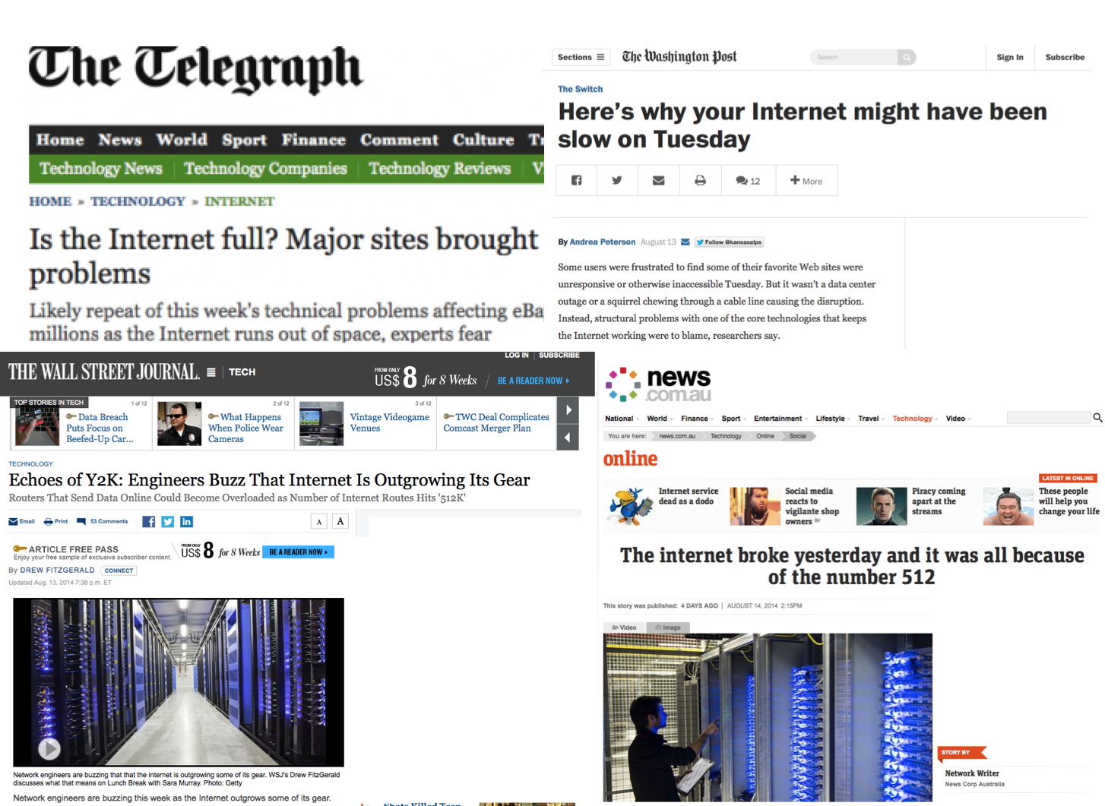
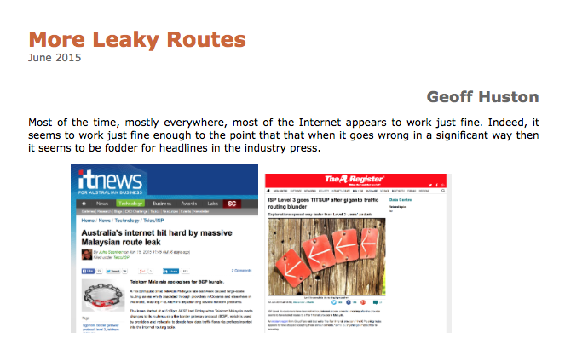
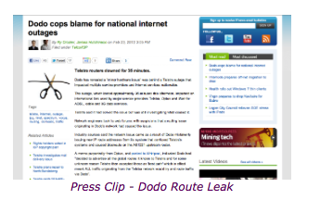
So we have routing “problems” from time to time

Slide 30
What SHOULD we be doing?

Slide 31

Routing Security A01
1. Protecting the routers
  Threat model:
    Compromised router used to insert corrupted address information into your network’s routing tables
    Insert corrupt reachability information into your network’s forwarding tables
    Allow the routing protocol to disseminate the corrupted information across the entire internet
  Response:
    Secure your routers!

Slide 32
Routing Security A01
1. Protecting the routers
  Threat model:
    Compromised router used to insert corrupted address information into your network’s routing tables
    Insert corrupt reachability information into your network’s forwarding tables
    Allow the routing protocol to disseminate the corrupted information across the entire internet
  Response:
    Secure your routers!
This is up to you, and the tools and operational practices are widely disseminated to achieve this – it’s not rocket science!

Slide 33
Routing Security A02
2. Protecting routing protocols and their operation
  Threat model:
    Disrupt the operation of the routing protocol by a “man-in-the-middle” attack
    Compromise the topology discovery / reachability operation of the routing protocol by injection of false routing information
  Response:
    Current operational best practice uses TCP-MD5 and avoids multihop for all eBGP sessions
MITM
Inject: 10.0.1.0/24
eBGP multihop session in the clear

Slide 34
Routing Security A02
2. Protecting routing protocols and their operation
  Threat model:
    Disrupt the operation of the routing protocol by a “man-in-the-middle” attack
    Compromise the topology discovery / reachability operation of the routing protocol by injection of false routing information
  Response:
    Current operational best practice uses TCP-MD5 and avoids multihop for all eBGP sessions
This is up to you and your eBGP peers, and the tools and operational practices are widely disseminated to achieve this – again, it’s not rocket science!
MITM
Inject: 10.0.1.0/24
eBGP multihop session in the clear

Slide 35
Routing Security A03
3. Protecting the routing protocol payload
  Threat model:
    Insert corrupted address information into your network’s routing tables
    Insert corrupt reachability information into your network’s forwarding tables
    Allow the routing protocol to disseminate the corrupted information across the entire internet
  Response:
    ?
AS 666
Routing attack on
10.0.1.0/24
AS 3
AS 4
10.0.0.0/8 (3,2,1)
10.0.0.0/16 (4,3,2,1)

Slide 36
Routing Security A03
3. Protecting the routing protocol payload
  Threat model:
    Insert corrupted address information into your network’s routing tables
    Insert corrupt reachability information into your network’s forwarding tables
    Allow the routing protocol to disseminate the corrupted information across the entire internet
  Response:
    ?
AS 666
Routing attack on
10.0.1.0/24
10.0.1.0/24 (666,1) NO EXPORT
AS 3
AS 4
10.0.0.0/8 (3,2,1)
10.0.0.0/16 (4,666,1)

Slide 37
Routing Security A03
3. Protecting the routing protocol payload
  Threat model:
    Insert corrupted address information into your network’s routing tables
    Insert corrupt reachability information into your network’s forwarding tables
    Allow the routing protocol to disseminate the corrupted information across the entire internet
  Response:
Unfortunately, detecting and preventing this could well be rocket science!
AS 666
Routing attack on
10.0.1.0/24
10.0.1.0/24 (1,666) NO EXPORT
AS 3
AS 4
10.0.0.0/8 (1,2,3)
10.0.0.0/16 (1,666)

Slide 38
Can we “tweak” BGP so that it can detect the difference between good and evil, and only advertise and propagate the “good” routes?

Slide 39
Routing Security
The basic routing payload security questions that need to be answered are:
  Who injected this address prefix into the network?
  Did they have the necessary credentials to inject this address prefix? Is this a valid address prefix?
  Is the forwarding path to reach this address prefix trustable?
And can these questions be answered by any BGP speaker quickly and cheaply?

Slide 40
A (random) BGP Update
2015/01/26 00:03:35 rcvd UPDATE w/ attr:
nexthop 203.119.76.3, origin i, path 4608 1221 4637 3561 3356 4657 4773
124.197.64.0/19

Slide 41
BGP Update Validation
2015/01/26 00:03:35 rcvd UPDATE w/ attr:
nexthop 203.119.76.3, origin i, path 4608 1221 4637 3561 3356 4657 4773
124.197.64.0/19
Is 124.197.64.0/19 a “valid” prefix?
Is AS4773 a “valid” ASN?
Is 4773 an “authorized” AS that is permitted to advertise a route to this prefix?
Is the AS Path “valid”?
  Is AS 4657 a valid AS, and did AS 4773 advertise this route to AS 4657?
  Is AS 3356 a valid AS, and did AS 4657 advertise this route to AS 3356?
  Etc
Does this AS Path represent a viable forwarding path to reach this address prefix?

Slide 42
The Basics of Update Validation
The VALIDITY of the Address and AS number
The AUTHORISATION provided by the address holder to permit the AS to originate the route
The CORRECTNESS of the path to reach the destination

Slide 43
Approaches to Validity
The awesome power of Whois!
Entries in a routing registry
Delegation of reverse DNS zone
Certification of an allocation registry entry
All of these approaches rely on some form of trusted third party attestation to provide information about the address
The credentials of the party holding the address are not well described in the first two approaches
For reverse DNS it’s the delegated zone admin
For certification it’s the holder of the private key

Slide 44
None of these Approaches are a Perfect Fit
Route Registries:
The route registry model relies on the maintenance of a trustable registry write access model. Too often this access model becomes a Mail From access or user / password. Efforts to move to keyed access and user certs have often foundered on user resistance to cert management tools in user systems
There is no single IRR, but many IRRs each with partial (and sometimes conflicting data) or dubious quality and uncertain validity
The Route Registry Object access model is variously implemented
All this can be improved, but to do so probably requires keys (and certs) and signed objects
In theory, and practice, this can work for a diligent, mutually trusting community using simple origination registry objects
If you operate a network high in the interconnection hierarchy, then the large ACL filters pose a scaling issue in terms of router config / state bloat
The operating overhead of maintaining current accurate data is high and the integrity of the route registry contents is vulnerable to bad actors

Slide 45
None of these Approaches are a Perfect Fit
Populating Reverse DNS:
The reverse DNS model does not cleanly map across CIDR delegations
  It can be coerced to do so, but its not a smooth fit
The approach relies on integrity of zone delegation and management
Mapping AS numbers?
  How can you answer “assemble the list of all addresses originated by an AS” if all you have in the reverse DNS is address -> AS mapping
Integrity of critical information in the DNS really needs DNSSEC
  Which in turn implies private key management tools and practices on the part of address holders
Would this approach be a case of overloading the DNS?

Slide 46
None of these Approaches are a Perfect Fit
Number PKI:
A PKI for Addresses and AS numbers has issues has its own issues
Key / Cert management for a new PKI requires a dedicated tool set
End User unfamiliarity with managing keys is an issue
Current hardware and software tools for use in this PKI tend to be “raw” and they expose much of the underlying mechanics of the crypto system to the user
Distribution of Certificates and CRLs using “just in case” flooding and runs into a novel set of issues of distribution and synchronization of routing information and the associated credentials that need to be used to validate the routing information

Slide 47
But

Slide 48
A Foundation for Routing Security
  A PKI for addresses and ASNs makes a lot of sense: (*)
    Use digital signatures to both the integrity, the authenticity and the currency of the signed data. This allows systems to automatically validate attestations about addresses and their use
    Digital signatures that can be validated in this PKI can be used to sign:
      Route Registry Entries
      Route Requests
      BGP
* Yes, that’s a personal opinion!

Slide 49
But what about BGP?
What are the trade-offs in adding any of these approaches into the context of BGP?
  How a BGP speaker can be assured that the origination of the route is valid?
  And that the AS path that is being presented is an authentic representation of a viable forwarding path to the address?

Slide 50
BGP Elements
Origination
  Is the address valid?
  Is the origination of this route a duly authorized use of this address?
Path
  Is the forwarding path represented in the route an authentic path?
  If I pass a packet into this path will it get to its intended destination?

Slide 51
BGP Origination (1)
Managed Filters
  Filter lookup is fast within the router, and filter construction can be undertaken by a trusted off-unit subsystem, using an incremental difference sync protocol to keep the router state in sync
  Route Registry model of declaring in advance what addresses you may advertise to your BGP peers
    The peer constructs an acceptance filter based on this list
  RPKI ROA model of declaring in advance what addresses you may advertise to your BGP peers
    The peer constructs an acceptance filter based on this list
  This is a “just in case” provisioning model (all filtered systems install filters for all ROA-managed prefixes)

Slide 52

A filter-based architecture for securing BGP origination
eBGP
Router
Local Route
Policy Engine
BGP Filter
(Origin AS +
prefix mask)
Distribution /
Synchronisation
Route Origination Information
(Route Registries or RPKI certs and ROAS)

Slide 53
BGP Origination (2)
Update Filtering
  Update filtering allows the credential information to be passed with the data, allowing for “just in time” delivery of credentials and information
  Can be undertaken on-board, or outsourced to update filtering BGP route server(s) within each AS
  RKPI ROA attached to the update as an opaque transitive attribute?
    BGP bloat?
    Digital signatures plus PKI Certs can add significant size to updates and processing load to routers (as in a BGP peer session reset)
  Or perform a Reverse DNS lookup
    Validate originating AS through a DNS query of the prefix

Slide 54
A update-based architecture for securing BGP origination
Address
Y/N
Origin AS
AS Path
eBGP
Router
Origination
Credentials
Local Validation
Function
Address
BGP
Update
Origin AS
Origination
Credentials
+
Local Trust Material

Slide 55
Path Validation
Origination validation reduces the attack surface, but an attacker can still inject bogus routes as long as it synthesizes the specified originating AS in the bogus route entry
So while origination protection is a good initial step, it is just an initial step and by itself its not a completely adequate approach to routing security
But how far (and at what cost) should we go to secure AS Paths?

Slide 56
Option a:
Route Registries and RPSL
Using RPSL and various forms of export and import attestations in a route registry it is feasible to construct AS Path filters that allow a BGP speaker to filter out implausible AS Paths from incoming updates
In practice RPSL has never really gained widespread acceptance. Some communities have worked hard to promulgate its use, but overall it has been unable to achieve widespread adoption and the effort / benefit equation looks like its unsustainable

Slide 57
Option b:
AS Path Validation and BGPsec
BGPsec proposes a strict form of AS Path validation where each eBGP speaker uses its own digital key to sign across the path and the AS to whom the update is being sent
It is not possible for a third party to construct a bogus route in this scenario unless it gains access to keys
But this sequence of interlocking signatures implies:
  BGPsec routers are required to unchain the signature set and match it to the AS Path in the update, using the local RPKI cache to validate the router signatures
  BGP bloat in carrying interlocking signatures
  a high crypto processing overhead in processing updates in the router
  no useful validation in cases of piecemeal adoption of BGPsec

Slide 58
Option c:
AS Adjacency and soBGP
In soBGP a pair of adjacent ASs publish and propagate a signed AS Adjacency Attestation, saying that they peer directly and exchange routes
If a BGP speaker receives a AS Path it can break the path into a sequence of AS adjacency pairs and determine if the AS Path represents a plausible transit path through the network based on signed adjacencies
This plausibility test can be performed through a filter operation performed on received updates, either on-board or off-loaded

Slide 59
Concerns
A major issue here is that of partial use and deployment
  This security mechanism has to cope with partial deployment in the routing system
    The basic conventional approach of “what is not certified and proved as good must be bad” will not work in a partial deployment scenario
  In BGP we need to think about both origination and the AS Path of a route object in a partial deployed environment
    AS path validation is challenging indeed in an environment of piecemeal use of secure credentials, as the mechanism cannot tunnel from one BGPsec “island” to the next “island”
  A partially secured environment may incur a combination of high incremental cost with only marginal net benefit to those deploying BGPsec

Slide 60
Concerns
Is a trust hierarchy the best approach to use?
  The concern here is concentration of vulnerability
    If validation of routing information is dependent on the availability and validity of a single root trust anchor then what happens when this single digital artifact is attacked?
  But is there a viable alternative approach?
    Can you successfully incorporate robust diversity of authentication of security credentials into a supposedly highly resilient secure trust framework?
This is a very challenging question about the nature of trust in a diverse networked environment!

Slide 61
Concerns
Is certification the only way to achieve useful outcomes in securing routing?
  Is this form of augmentation to BGP to enforce “protocol payload correctness” over-engineered, and does it rely on impractical models of universal adoption?
  Can various forms of routing anomaly detectors adequately detect the most prevalent forms of typos and deliberate lies in routing with a far lower overhead, and allow for unilateral detection of routing anomalies?
  Or are such anomaly detectors yet another instance of “cheap security pantomime” that offer a thinly veiled placebo of apparent security that is easily circumvented or fooled by determined malicious attack?

Slide 62
What are we trying to do?
Is securing the routing system alone actually enough?
  Can you validate the “correctness” of the forwarding paths being proposed by a routing system?
    Is secure routing helpful in and of itself?
    Or this this just pushing the vulnerability set to a different point in the network integrity space?
    Does this adequately reduce the level of exposure to attack?
    Is BGP too incomplete in terms of its information distribution properties to allow robust validation of the intended forwarding state?
If not, then is this a case of too high a cost or too low a benefit?
  Is this a case of reducing the security credential generation and validation workload by reducing the security outcomes through reduced trust and/or reduced amount of validated information
  Or is this a case of increasing the level of assurance and the amount of routing information secured by these mechanisms

Slide 63
What are we trying to do?
Is Partial Deployment of any value?
  Are the semantics of routing security and incomplete credentials compatible concepts?
    Can you deploy high integrity security using partial deployment scenarios?
    The issue here is that credentials can assure a recipient that the information that they receive are authentic. They can mark what’s “good”. But the aim of the exercise is to identify what’s “bad”.
    In a scenario of comprehensive deployment, then the inability to determine “good” implies “bad”
    In partial deployment scenarios the inability to determine “good” means…?

Slide 64
Good, Fast, or Cheap?
Pick one!
We just can’t make secure routing mechanisms cheaper, faster, more robust, and more effective than existing routing tools …
  We can make it robust, but it won’t be cheap, and probably not fast!
  We can make it fast, but it won’t be robust and it won’t be cheap!
  We can make it cheap, but it won’t be completely robust!

Slide 65
Good, Fast, or Cheap?
Pick one!
We just can’t make secure routing mechanisms cheaper, faster, more robust, and more effective than existing routing tools …
  We can make it robust, but it won’t be cheap, and probably not fast!
  We can make it fast, but it won’t be robust and it won’t be cheap!
  We can make it cheap, but it won’t be completely robust!
So where should we compromise in the design of a secure routing infrastructure?

Slide 66
Caution: Opinions!
My personal view of design compromise:
  Improve the robustness of RPKI certs by altering the cert validation algorithm
  Place origination signatures, ROAs and certs into the BGP protocol updates as opaque attributes
  Use AS Adjacency attestations in preference to a fully signed path
  Place AS Adjacency attestations into BGP protocol updates as opaque attributes
  Exploit the use of TCP in BGP to never resend already sent certs
  Flatten parts of the CA hierarchy by using RAs rather than CA delegations
  Reduce OOB credential distribution to TA material
    For which you can use the DNS and DNSSEC if you really want!
  Like all the other approaches, this represents a particular set of compromises about speed, complexity, cost, deployment characteristics and robustness – it has it’s weaknesses in terms of comprehensive robustness, but it attempts to reduce the number of distinct moving parts

Slide 67
Thank You
Questions?

Slide 68
Do you envision a world in the not so distant future where RPKI will be used to secure routing globally on an operational level; and if so when would you predict this will happen?
If you mean RPKI + BGPsec then this is just not going to happen in my opinion. Path Validation is just too difficult and Origin Validation is not enough by itself. So my answer is a bold: “never!” with BGPsec - The technology model needs to change before adoption begins to look feasible.
However, if we are allowed to look at other methods of Path Validation, then I can’t can’t see how we can build a validatable framework of routing addresses without using a validation framework based on this RPKI. In other words, any approach that tries to secure routing should take advantage of the RPKI, due to its ability to validate the implicit assertions made in a routing system

Slide 69
Can RPKI itself be attacked, misconfigured, or legally forced to misclassify a legitimate BGP route as bogus? Using the example of where DNS is subject to legal orders to take down domains; could RPKI be used to take down IP prefixes?
Yes, and yes.
The first question exposes some strange subtle aspects of PKIs. In an environment of multiple trust anchors, and where clients are free to choose whom they trust there is no “absolute” legitimacy.
There are issues with the validation algorithm in RPKI that allows windows of opportunity for otherwise valid routes to be classified as bogus. If you attack the local cache synchronisation mechanisms then you can play with a out of date cache, which can be used to categorise valid routes as bogus
Hypothetically, if an Australian court ordered APNIC to remove 203.10.60.0/24 from its trust anchor certificate then that prefix has a hypothetical problem. But ordering APNIC to REMOVE a resource from its TA set does not make it “unroutable.” It just makes it “not found”. We’d need an order to generate a ROA for 203.10.60.0/24 with an Originating AS of 0 to cause the route to be regarded as invalid . But as long as noone uses RPKI seriously its probably a very small problem! But IF we all start using RPKI as the trust foundation for the routing system then yes, it is a potential mechanism for takedowns.

Slide 70
Is it true that RPKI cannot prevent some classes of attacks - such as route leaks and path shortening attacks? Can you explain why this is?
The mechanisms in BGPSEC talk about correctness of the protocol, NOT correctness of policy.
Example: A is both a “customer” of Band a “customer of “C” . What if A forwarded all the routes it learned from B to C? C might believe A and hand to A all the traffic it would’ve passed through other connections to get to B, particularly if B is not directly connected to C. Obviously this is wrong, but in protocol terms there is no violation of BGP as a protocol, and BGPsec would not find anything wrong here.
Equally in this example there is nothing that is “wrong” or invalid in the context of the underlying RPKI. Its just that the routes are being passed through the network in a way that is counter to the policy-driven intention. Stopping leaks requires the formal statement of “intent” (policy) and including this intent into the framework (i.e. route registries).
The BGPsec model has avoided the concept of route policy objects, and frankly it seems daft to redo the old RPSL work. But that then brings us back to routing registries and their issues.

Slide 71
I have now created ROA objects for my resources in MyAPNIC. I understand the benefits of creating ROA objects. However, since ROA objects are still in a testing phase, will this achieve the benefits of creating ROA object? What will actually happen to my resources now?
Hopefully, nothing!
If you have been careful in the construction of your ROAs then some others will pick up these ROAs and construct BGP route admission filters. In the event that some third party attempts a route hijack of your routes using more specific prefixes and a false origin AS then the points in the network that use such ROA-based filters will filter out this.
Of course, if the attacker puts your AS in as the origin AS and advertised within the bounds of the permitted more specifics of your ROAS then the attack will be successful.
And of course , if you have not been careful and complete in the construction of your ROAs, or let your keys elapse, then you stand the risk of having your legitimate routes filtered!

Slide 72
Is ROA object and RPKI framework “standard” among all the RIR? If not, what are the differences?
The public key certificates, signed attestations and published products conform to the published RFCs – they are standards, and we believe that all the RIRs produce certificates that comply in every respect to the specifications described in the RFCs.
The Trust Anchors published by the RIRs are not all the same. In practice the differences are inconsequential as long as nothing goes wrong. APNIC’s practice is to includes only those resources that are listed in its database, but the cost of this accuracy is operational fragility. Other RIRs (e.g. ARIN) list 0/0 (all numbers) in its trust anchor. Operationally, this approach is robust, but in another sense it is a misrepresentation of the resources that are under the RIRs administrative control.

Slide 73
I did not receive the resources directly from APNIC. However, I am keen to set up the ROA objects to secure my announcement. How can I get these ROA objects created?
The trust implicit in the PKI is that each certificate issuer only issues certificates according to its published practices statement. APNIC has a published a practice statement that it issues certificates for resources that APNIC itself has allocated, AND ONLY THOSE RESOURCES, and it issues those certificates to those entities who received those resources AND ONLY THOSE SUBJECTS.
You need to speak to whoever allocated those resources to you and ask them for a certificate that covers those allocated resources that you did not receive directly from APNIC.

Slide 74
Would Route Origin Authorisation every become a mandate attribute with routing, if yes, the approximate time frame?
Personally, I doubt that this will happen anytime soon. What we have is still an early iteration of this technology (BGPsec) and I suspect that more ideas will emerge in the coming years that address some of the shortcomings in the BGPsec model.
It’s likely that ROAs will persist in any BGP security model – ROAs represent a minimal and useful testable attestation about the origination of a route into the routing system.

Slide 75
How could we up sell ROA? Benefits of ROA?
Errr Ummm – I wouldn’t go there myself!

Slide 76
Any technical aspects that Member Service staff should know to promote ROA into the community.
Well there are a number of considerations here
One view is that we (APNIC) undertake a simple Registry function.
There are very good reasons to have RPKI certificates over resources, and there are a wide set of opportunities to explore about how to use signed attestations to ensure that addresses are handled with integrity. ROAs are just one form of attestation and right now its one that has a set of issues that would mean that a responsible voice would be one of caution rather than “promotion”.

Slide 77
We usually say RKPI does not guarantee 100% routing security. If everyone has created their ROAs and everyone uses validators, what other threats exist for BGP routing security ?
If you lock the doors they can still come in the windows!
Without path security the ROA is not all that useful (as all you need to do is fake the origin) But even with path protection there are still problems with policy violations. And even then this does not get to the heart of the problem: what we actually want is certainty in forwarding, and strengthening the routing system is just one part of the larger problem.

Slide 78
Validators are an essential part of RPKI framework. What kind of a cost factor are we looking at if a large ISP wants to implement validators? And what kind of hardware is required?
The current approach to construction of filters (just in case) offloads the validation overhead for ROA validation, and the software solutions (typically based on OpenSSL libraries) on general commodity hardware are easily up to it.
Path validation is an entirely different problem, and validating a full route set following a BGP session restart requires some 2 – 5 million asymmetric crypto operations, and this cannot be readily outsourced from the BGP speaker. Its hard to see how this can happen

Slide 79
With cryptographic information, ROAs are relatively big objects. Validation may take bit of time too. Is there any possibility that the routing performance will go down (noticeably) because of RPKI ?
ROAS are NOT big objects – they are relatively compact ASN.1 data objects.
The implementation of ROAs as filters has no real impact on routing performance, with the possible exception of an increased update load through route refresh operations. But this is not a major factor for routing performance.
But, as with the previous response, path validation is an entirely different problem, and BGPsec-style and validating a full route set following a BGP session restart requires some 2 – 5 million asymmetric crypto operations, and this cannot be readily outsourced from the BGP speaker. Its hard to see how this can happen. Path validation is not going to happen easily.

Slide 80
Is ROA intended to ultimately replace route objects or will it need to coexist with route objects? If coexist: What is the operational difference between ROA and route object? Why should network operators worry about maintaining both these objects?
I assume you mean a “route object in a routing registry”. The difference is the policy framework – a ROA associates a prefix with an originating AS. A route object is capable of associating a prefix with an AS with a routing policy
In theory, if you had signed route objects you would not need ROAs, but not vice versa. But we don’t have signed route objects, and that means that the route registry system is lacking in explicit validation capability. There are other problems with route registries including currency, completeness and consistency.

Slide 81
If they won’t coexist: Route objects are used for both human and router consumption. Our members often ask us to register route object and then verify visually that the object is visible in their choice of IRR. The ROA object is a binary file stored in repositories only meant for router consumption. People can not visually see if a ROA is created for a prefix or not. Shouldn’t the registries provide some mechanism for relying parties to visually see what ROAs are created like they can for route objects by querying IRRs?
When we designed the ROA system we thought about what tools we would build and deploy and what we would leave to others to build. It’s a good question about what we should do as APNIC using member’s resources and what we should leave for others to do.

Slide 82
Please show me the actual configuration in BGP router which relates with RPKI.
bgp rpki server 192.168.179.3 port 43779 refresh 60
route map validity-0
match rpki valid
set local-preference 100
route map validity-1
match rpki not-found
set local-preference 50

Slide 83
What type of equipment and the average cost for ISP or a company to run this service.
RPKI relying party software (rpki.net)
*nix server
Cisco / Juniper routers
Major cost components are investments in processes and expertise, not in equipment per se

Slide 84
What is the biggest issue if something goes wrong with the RPKI
system, and how does the ISP/company fix it. Do you have any specific example of what would go wrong? One of the example:
If there are networks on the other side can not validate and dropped the traffic, although everything in the IP source network side has been configured correctly.
How does the IP source network quickly identify this issue before the customer got affected.
There are many moving parts in this operation and much to go wrong. Keys expire, and if this occurs in a trust anchor than large parts of the RPKI can no longer be validated. If the local cache sync tool fails then similarly larges amount of the address space can no longer be validated.
But the implications to BGP are probably more to the bounds of ‘slight’ rather than ‘significant’. The reason is that validation is applied to updates, not to stored routes. So if a previously valid route is invalidated then that will only be apparent when that route is updated. This is good and bad – good in that the impacts of a PKI error are not immediately applied to the routing system and bad in that PKI problems may not be noticed for some time,

Slide 85
During MyNOG, someone presented how you can verify if the prefix have valid or invalid ROAs in your router configuration. Apparently not all routers supported this, would he know a list where we can verify what routers support this? (ex. Juniper apparently does not support this yet).
Speak to your router vendor. I do not sell routers.

Slide 86
Will RPKI be fully operational at all, if so when do we expect this to happen judging the percentage of ROAs created now (still low)? Any suggestions on how we get people to create their ROAs on top of the initiatives we do now?
Its hard to sell fragility, particularly if the supposed benefits are significantly discounted by the lack of Path validation.
ROAs are easily circumvented through Path manipulation, and only really protect against mis-origination leaks, which are not all that common
Path protection is significantly harder than Origin protection and noone is doing it. That makes it tough to “sell” ROAs when all it does is introduce new fragility factors and not much else

Slide 87
What is the difference of creating ROA objects than creating route objects with other Routing Registry (i.e. RADB)? Does creating ROA objects affect my actual routing configuration?
In both cases the object creator (ROA, IRR Route Object) is creating information that other people can use in their BGP configuration to populate a BGP filter.
However … a few folk use a general route registry to populate their routing filters. The data is not consistent and of dubious quality so it becomes a risk to use it to drive a routing filter. In theory only the prefix holder can create a valid ROA so there are fewer issues about authenticity of the data. But a ROA contains no policy information, so has a more limited application

Slide 88
If a member has a /22 and routes the /22 (only). Should they create a ROA with (and why?):
-no max length
-max length of /24 (in case of future requirement)
-max length of /22
/22 – otherwise they are opening the door for more specific attacks with origin spoofing

Slide 89
Should we be actively contacting our members with "invalids" and notify them? Is there a way of automatically notifying the network operators once their ROA becomes invalid?
Who made us the routing police?
By the way, “Invalidity” is NOT a global condition – it’s a local condition. Its relative to local trust anchors, which makes this a tougher proposition – there is no assured global in/out judgement here.

Slide 90
For some large organizations when creating ROA's they need to do their research first, then push it up to their management. What kinds of things can they add to their business case before submitting to their management?
To what extent do address holders see integrity of routing of their own addresses being their own responsibility, and to what extent do they see it as their upstream ISP problem or more generally SEP?
Some folk are happy to use APNIC’s online system to generate and maintain ROAs.
Some folk think its so important that they want to do it themselves and not rely on APNIC
Some folk don’t care enough to do it at all
Given that the investment / cost is nonzero and the benefits are arguable from the current very very low use of ROAs and BGPsec any of those responses are reasonable!

