Slide 1
Where are we with Securing Addressing and Routing?
Geoff Huston
Chief Scientist, APNIC

Slide 2
On the Internet…

Slide 3

…there are many ways to be bad!

Slide 4
An Ascending Scale of Badness
Port Scan for known exploits
  General annoyance
Spew spam
  Yes, there are still gullible folk out there!
Mount a fake web site attack
  And lure victims
Enlist a bot army and mount multi-gigabit DOS attacks
  Extortion leverage and general mayhem
Mount a routing attack
  And bring down an entire region / country / global network!

Slide 5

If I were really bad (and evil)…
I’d attack routing.

Slide 6
If I were really bad (and evil)…
Through routing I’d attack:
  the DNS root system
  isolate critical public servers and resources
  overwhelm the routing system with spurious information
And bring selected parts of the network to a complete chaotic halt!

Slide 7
How many advertisements in today’s BGP are “lies”?
We’ve all heard of the “YouTube” route hijack, and similar incidents of injecting false information into the routing system.
But the situation is a little more mundane than a few isolated high profile incidents - who uses addresses and AS numbers that are not registered as “in use” in our Internet number registry system?

Slide 8
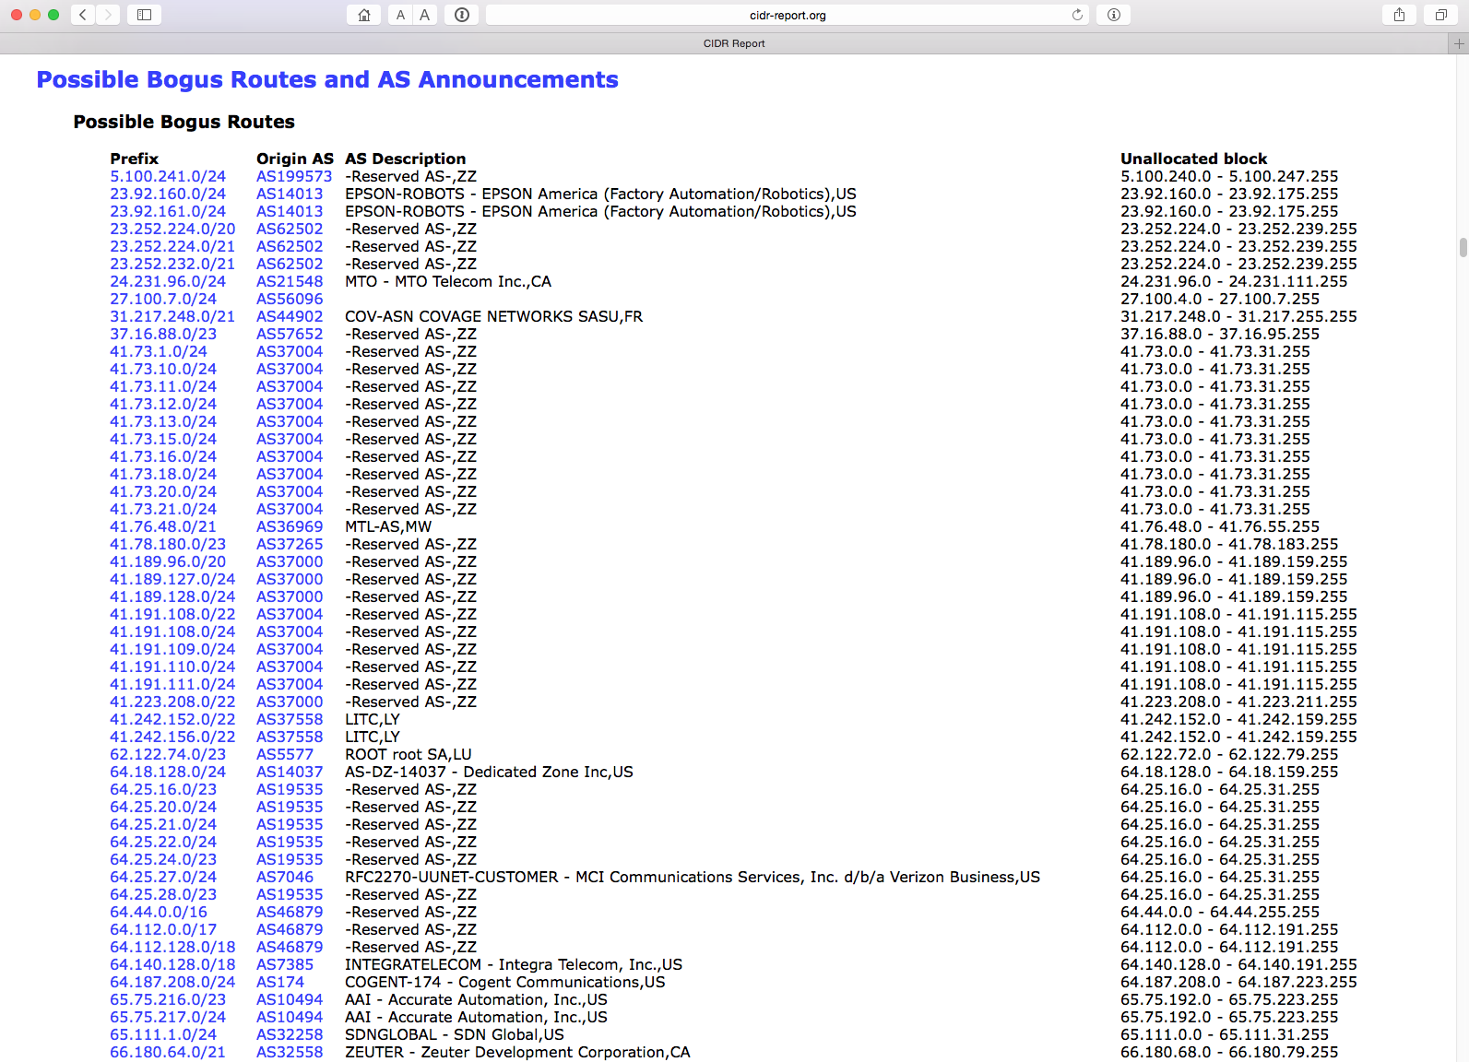
www.cidr-report.org

Slide 9
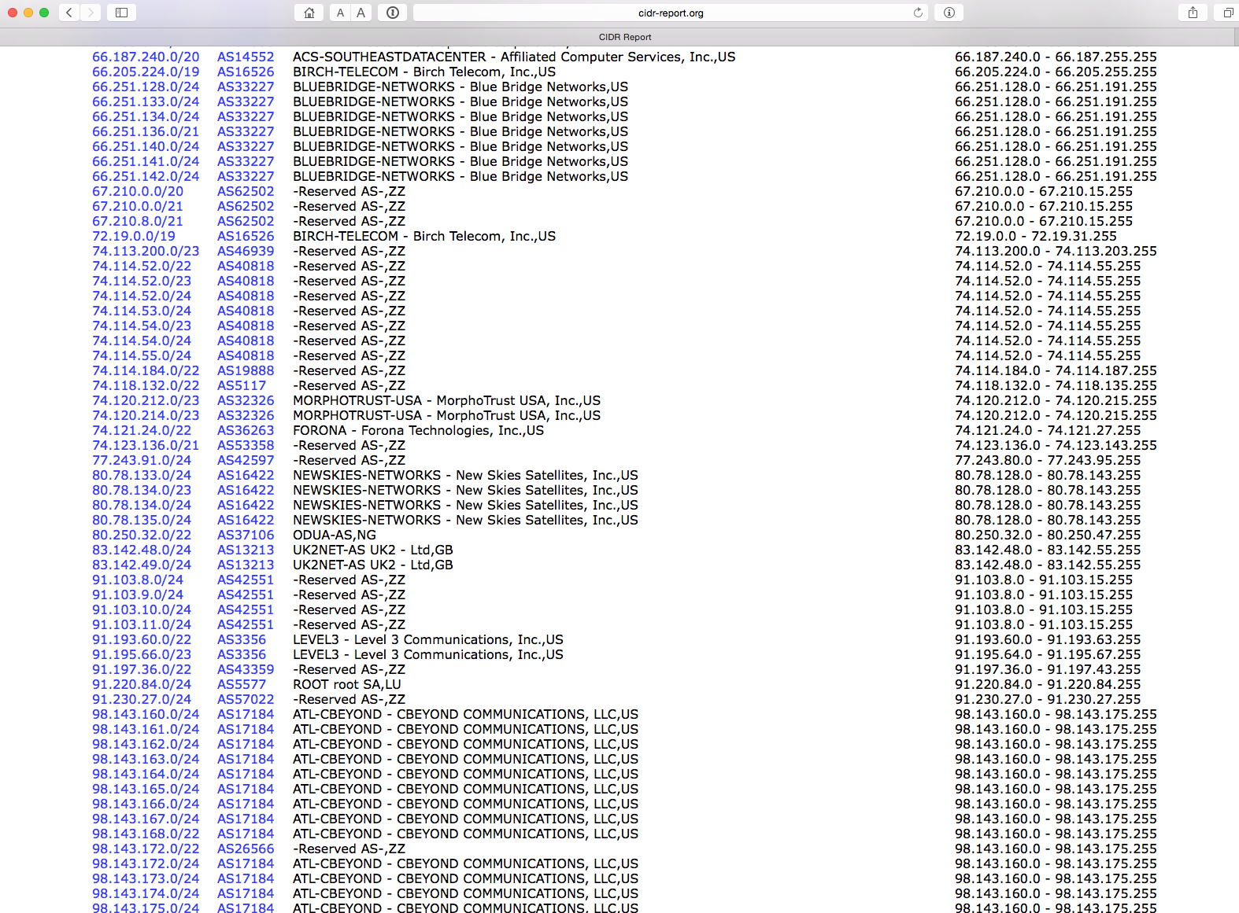
and…

Slide 10
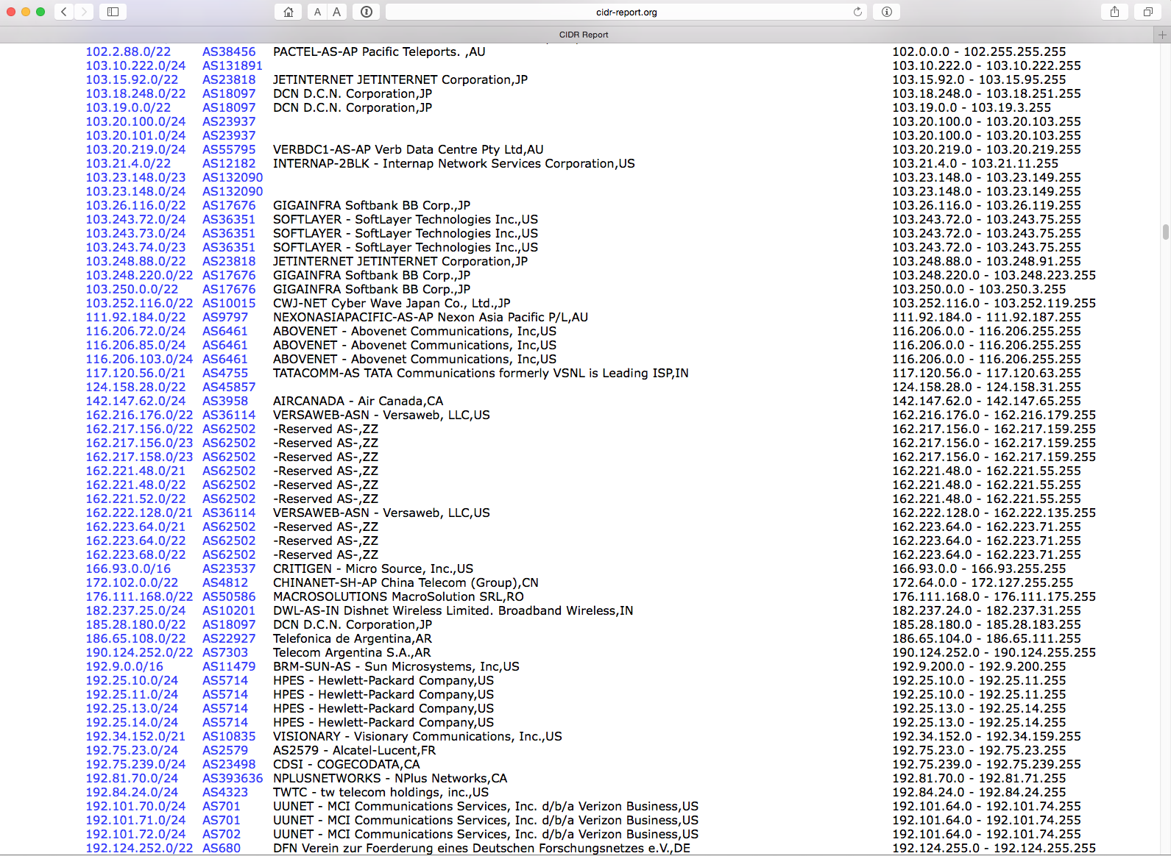
plus…

Slide 11
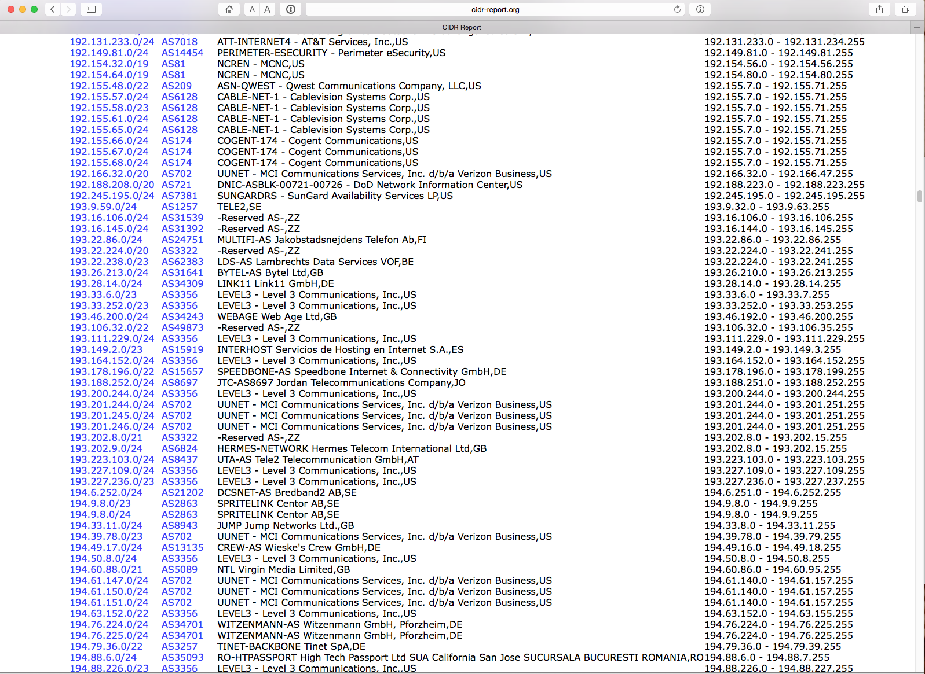
yes, there’s more

Slide 12
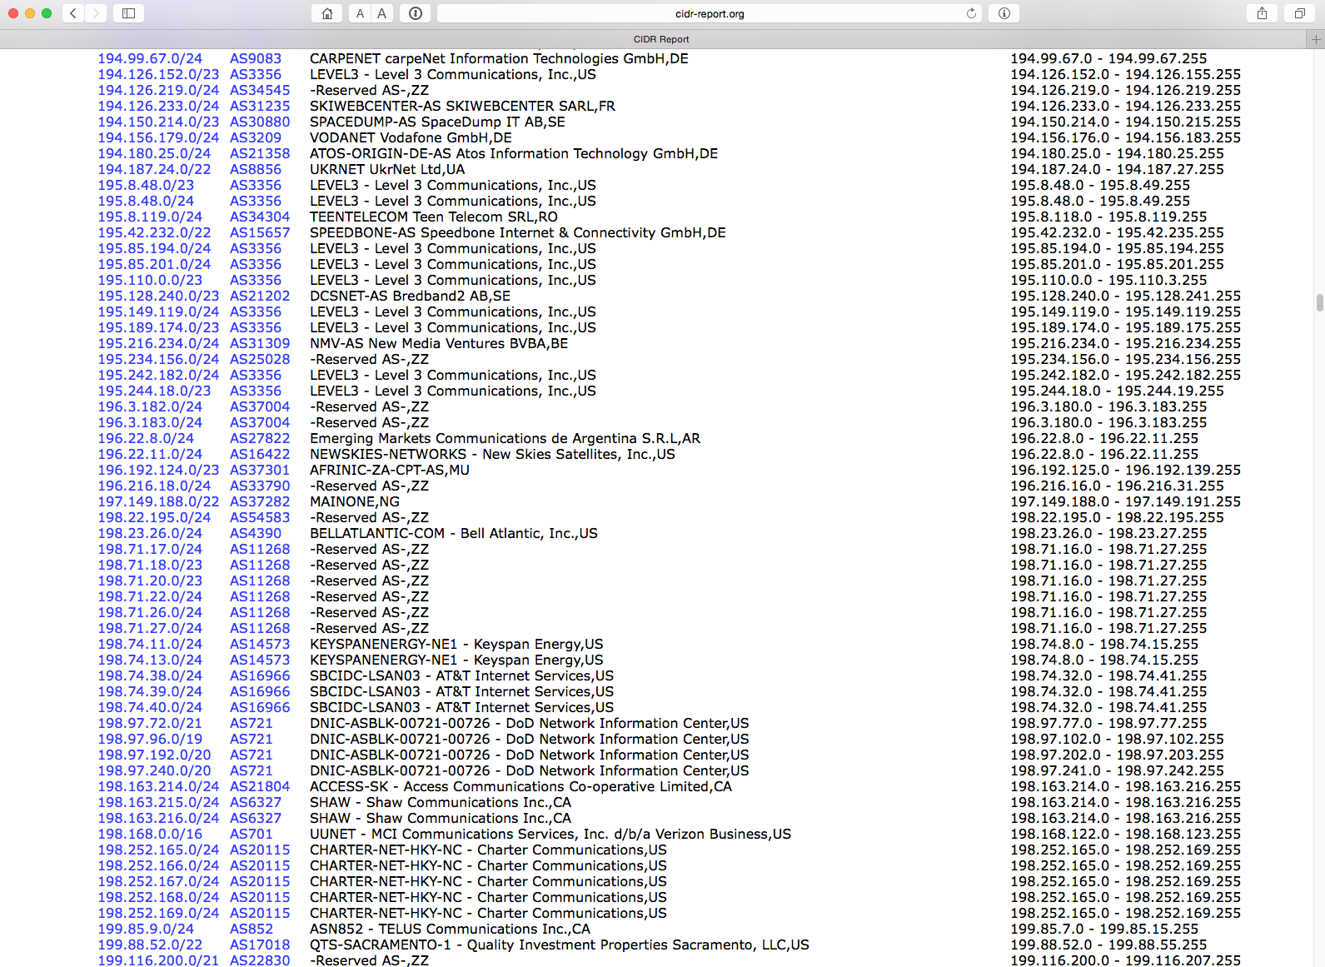
getting the point yet?

Slide 13
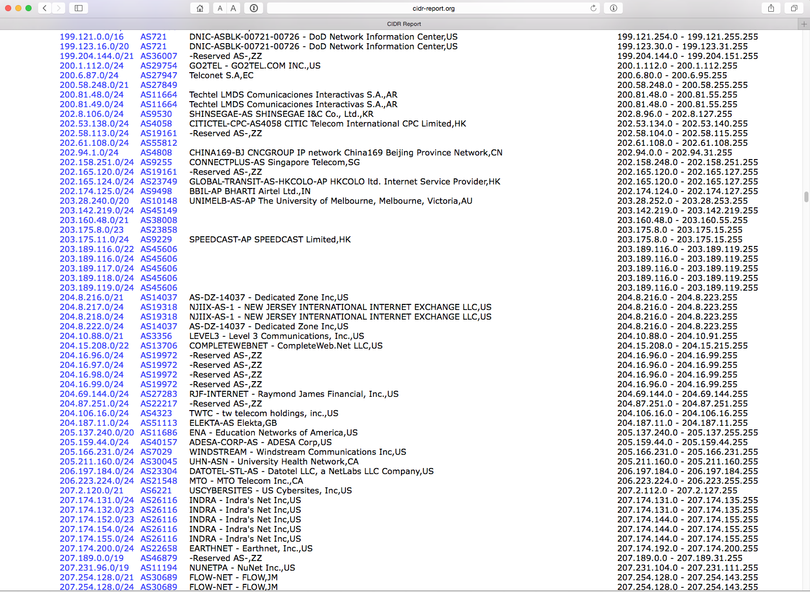
still more!

Slide 14
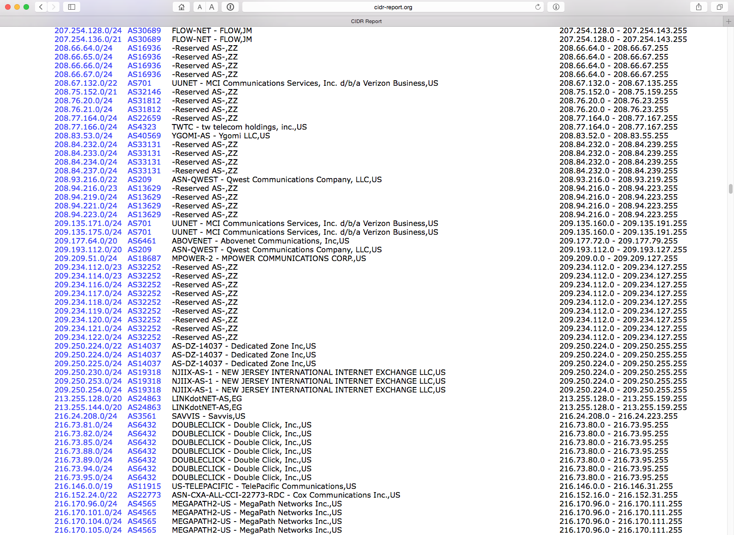
wake me up when we’re done

Slide 15
zzzzzzz

Slide 16
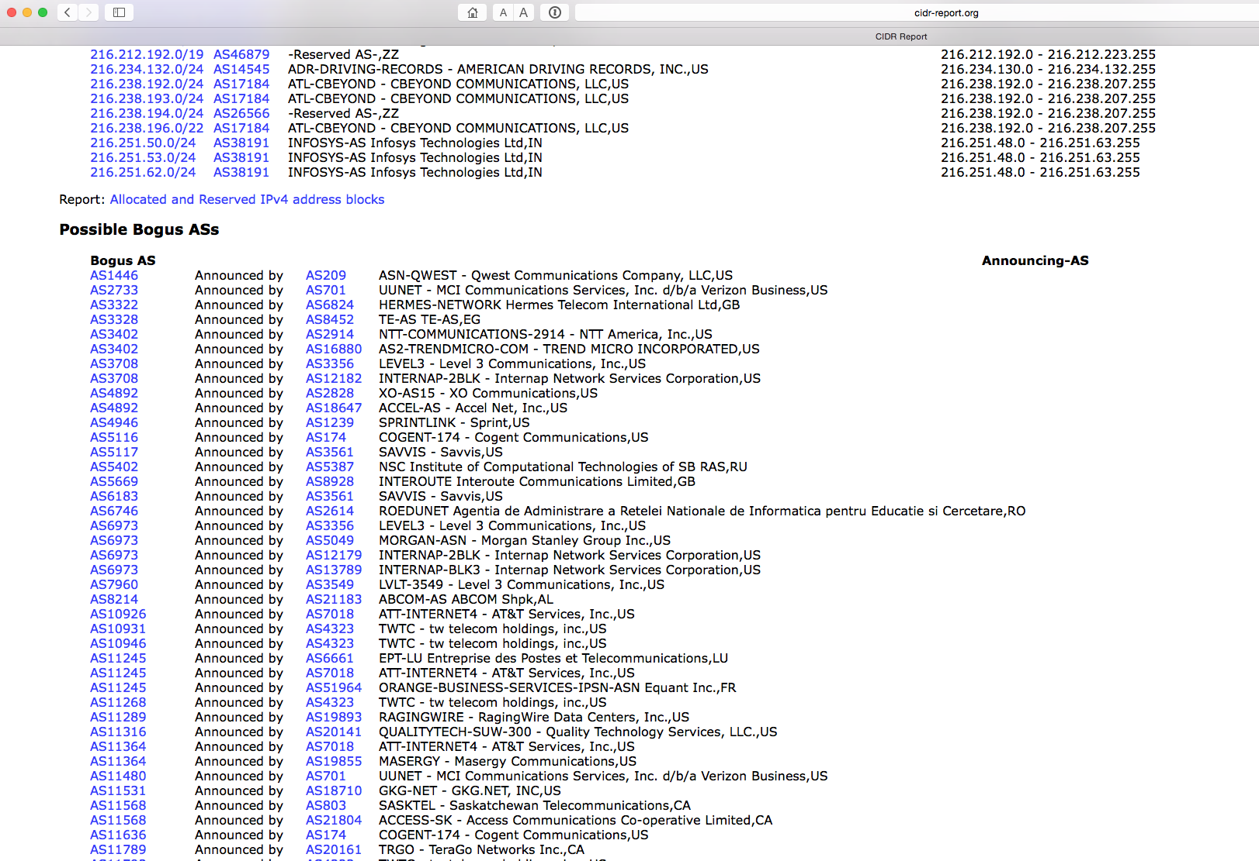
zzzzzzz

Slide 17
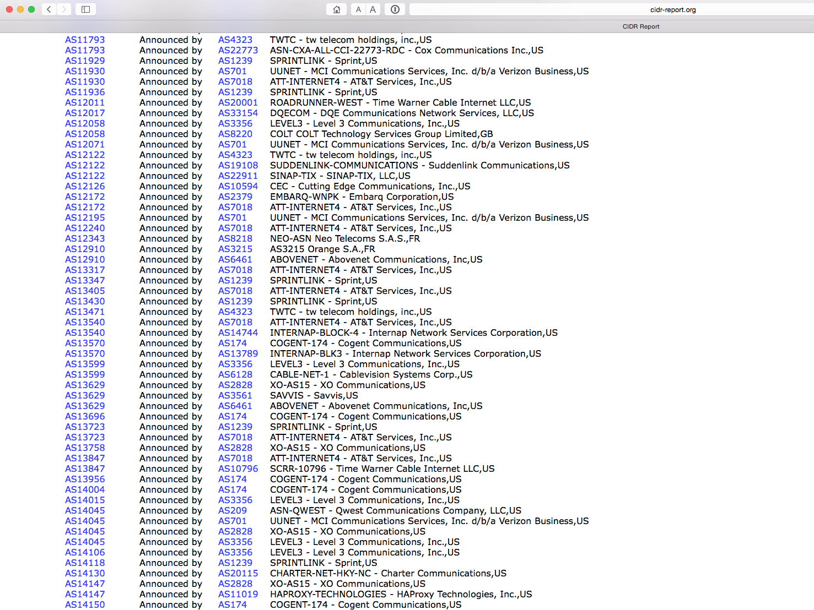
zzzzzzz

Slide 18
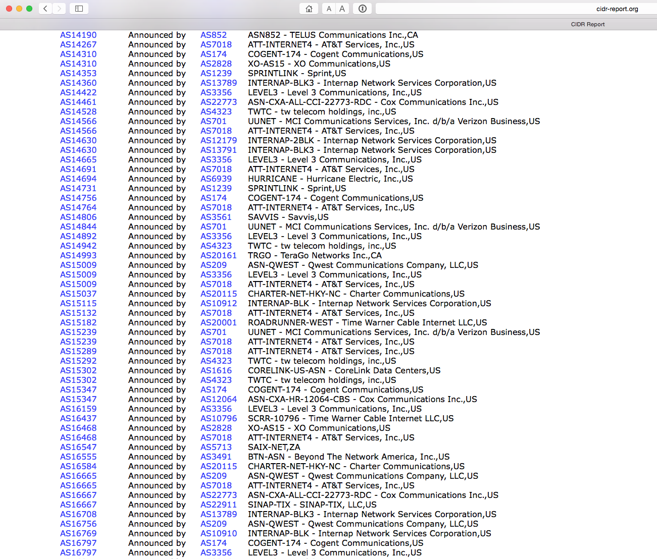
zzzzzzz

Slide 19
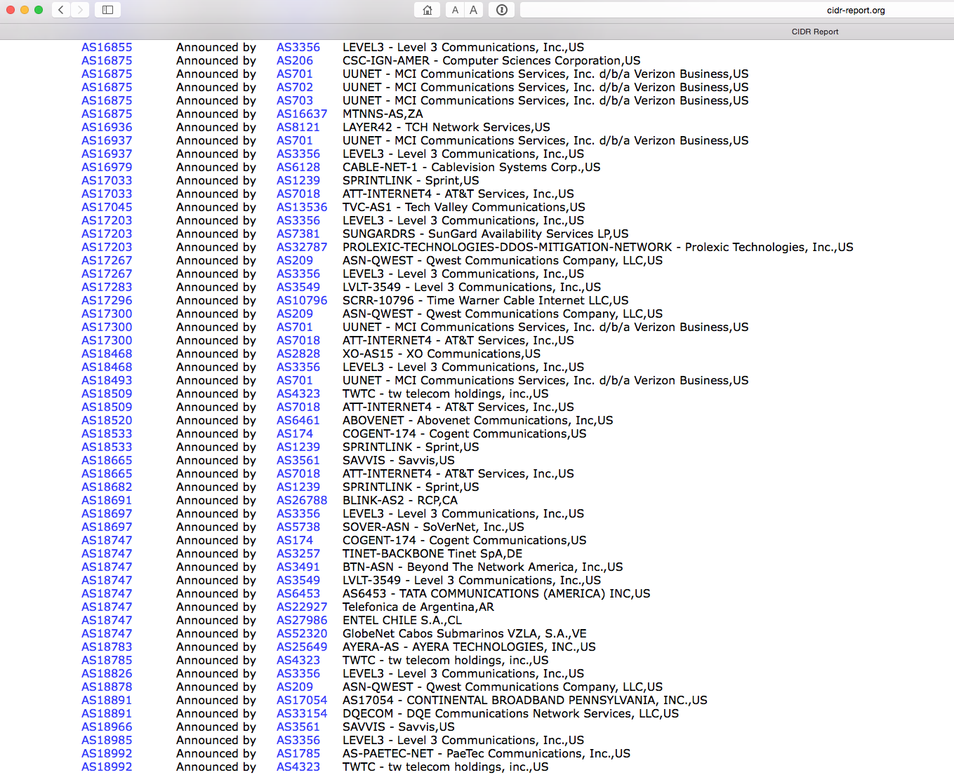
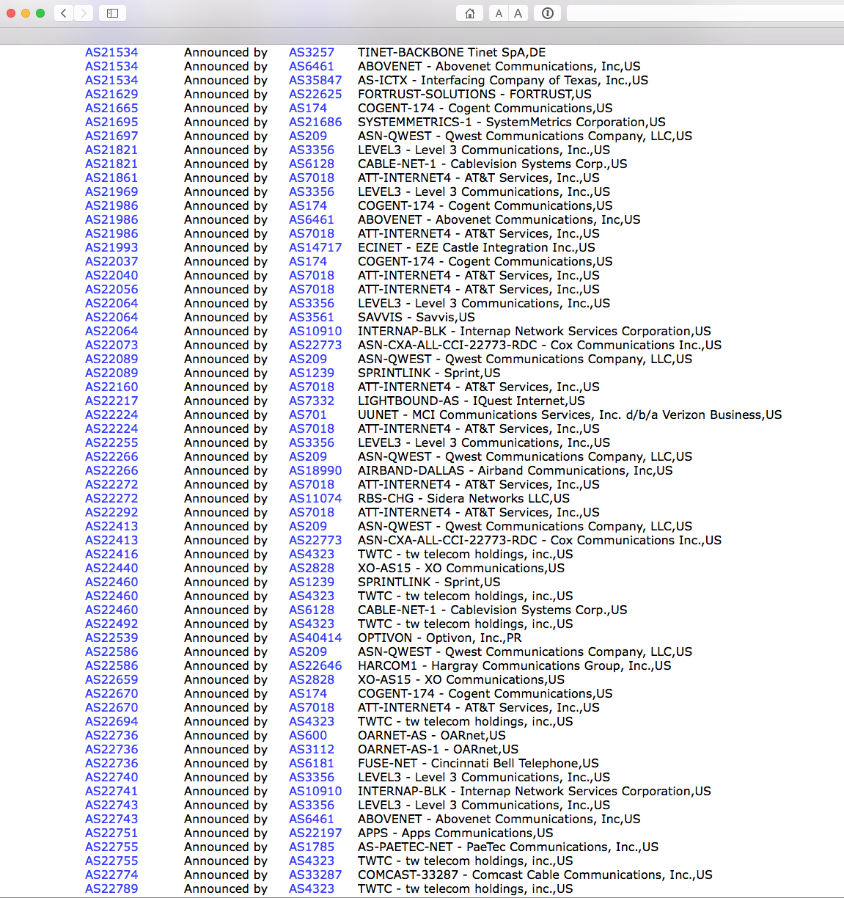
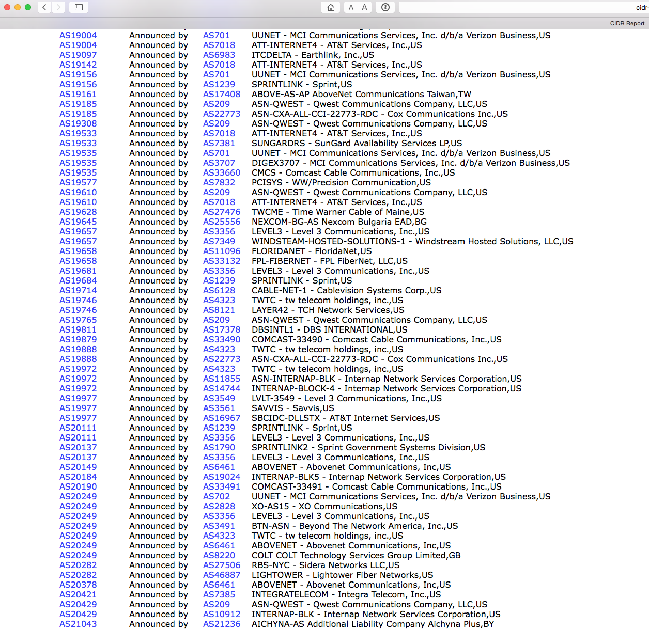
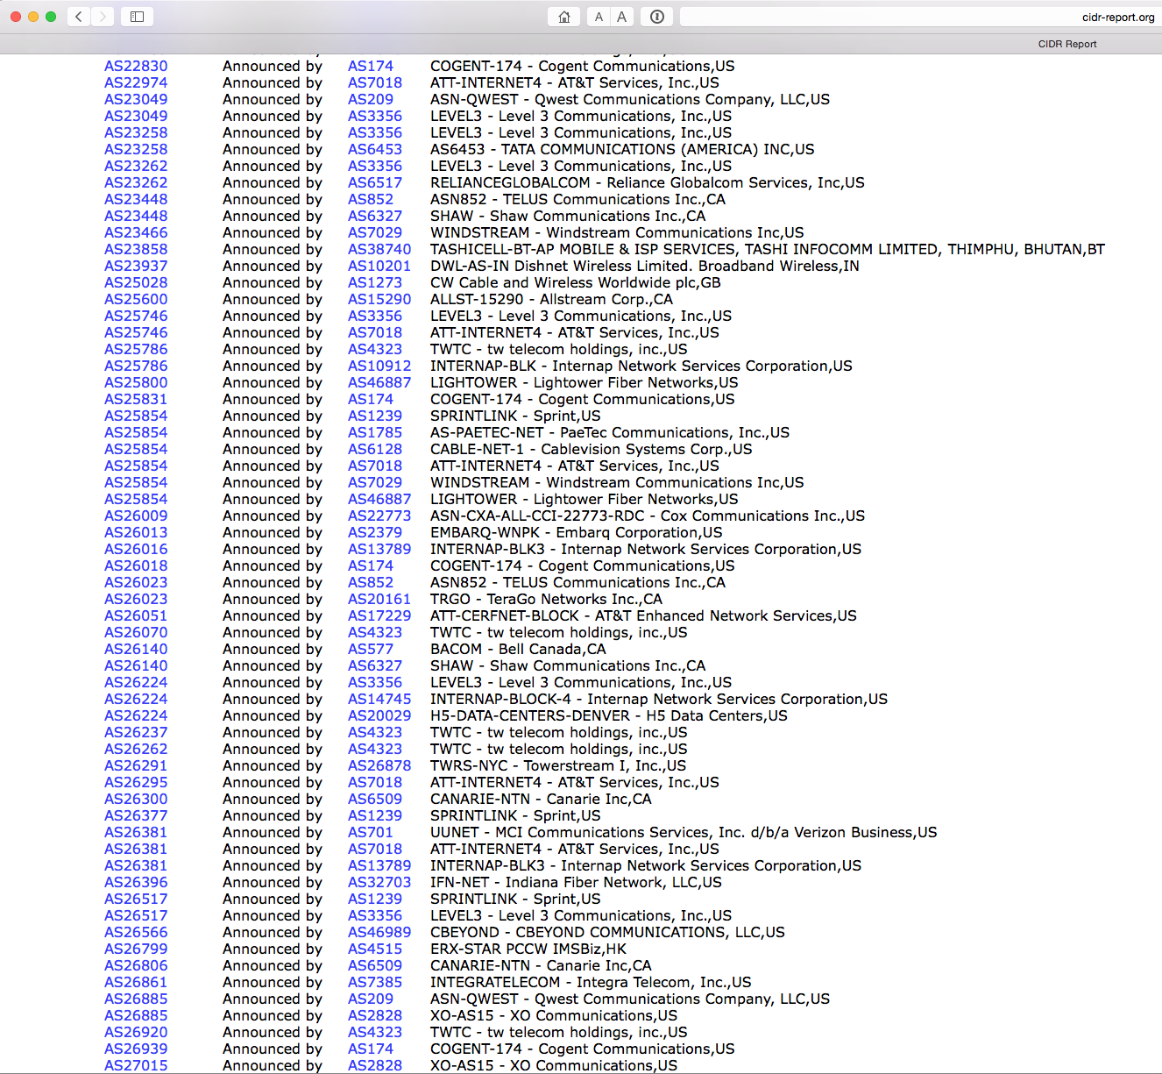
let’s speed this up…

Slide 20
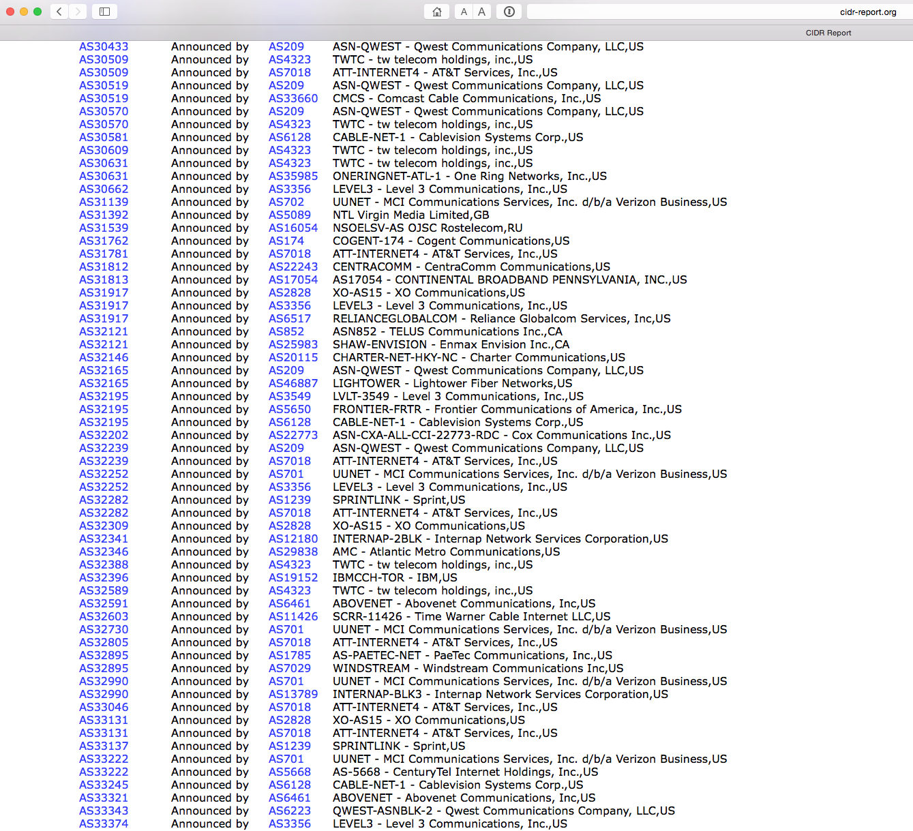
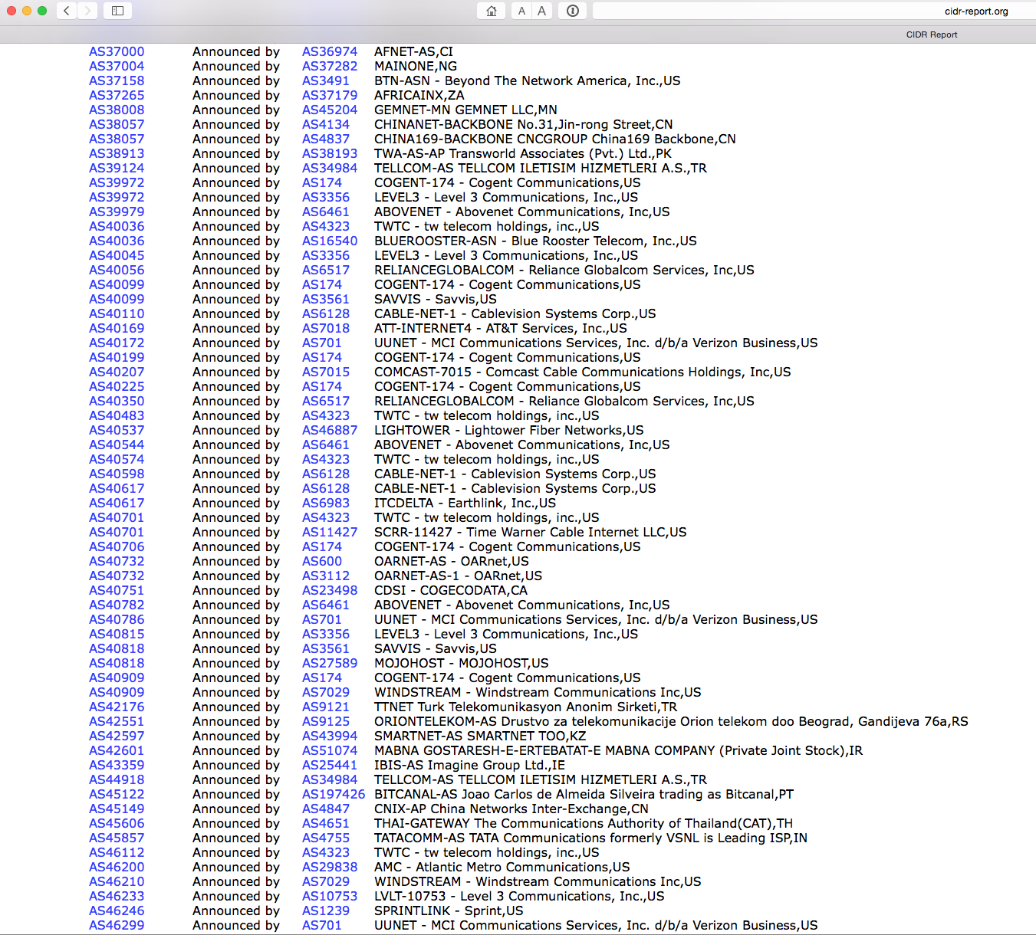
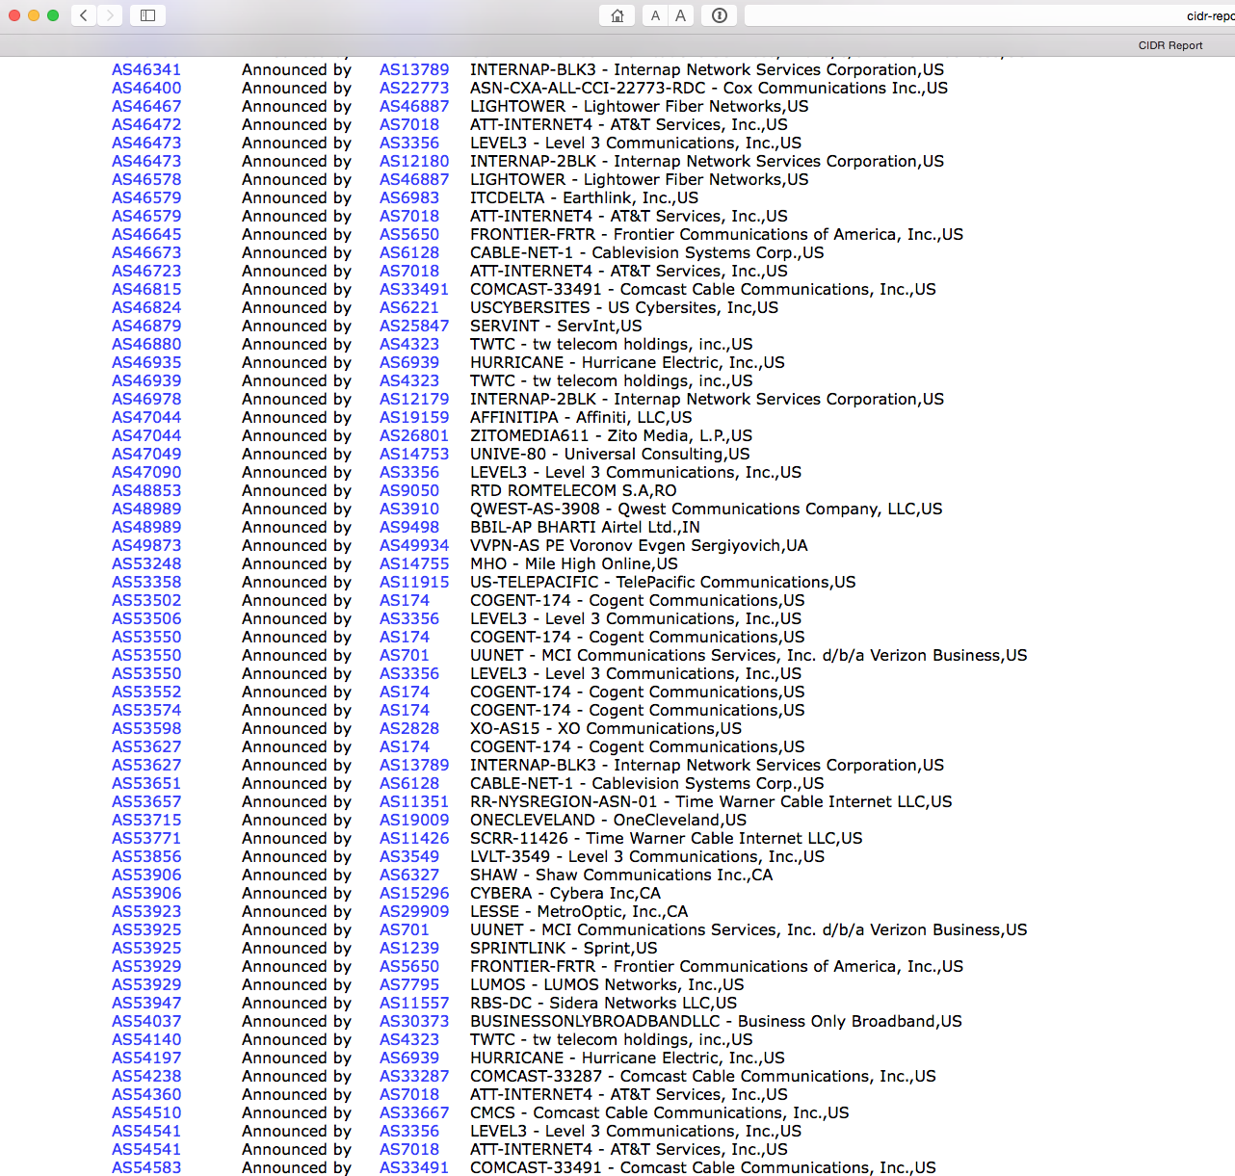
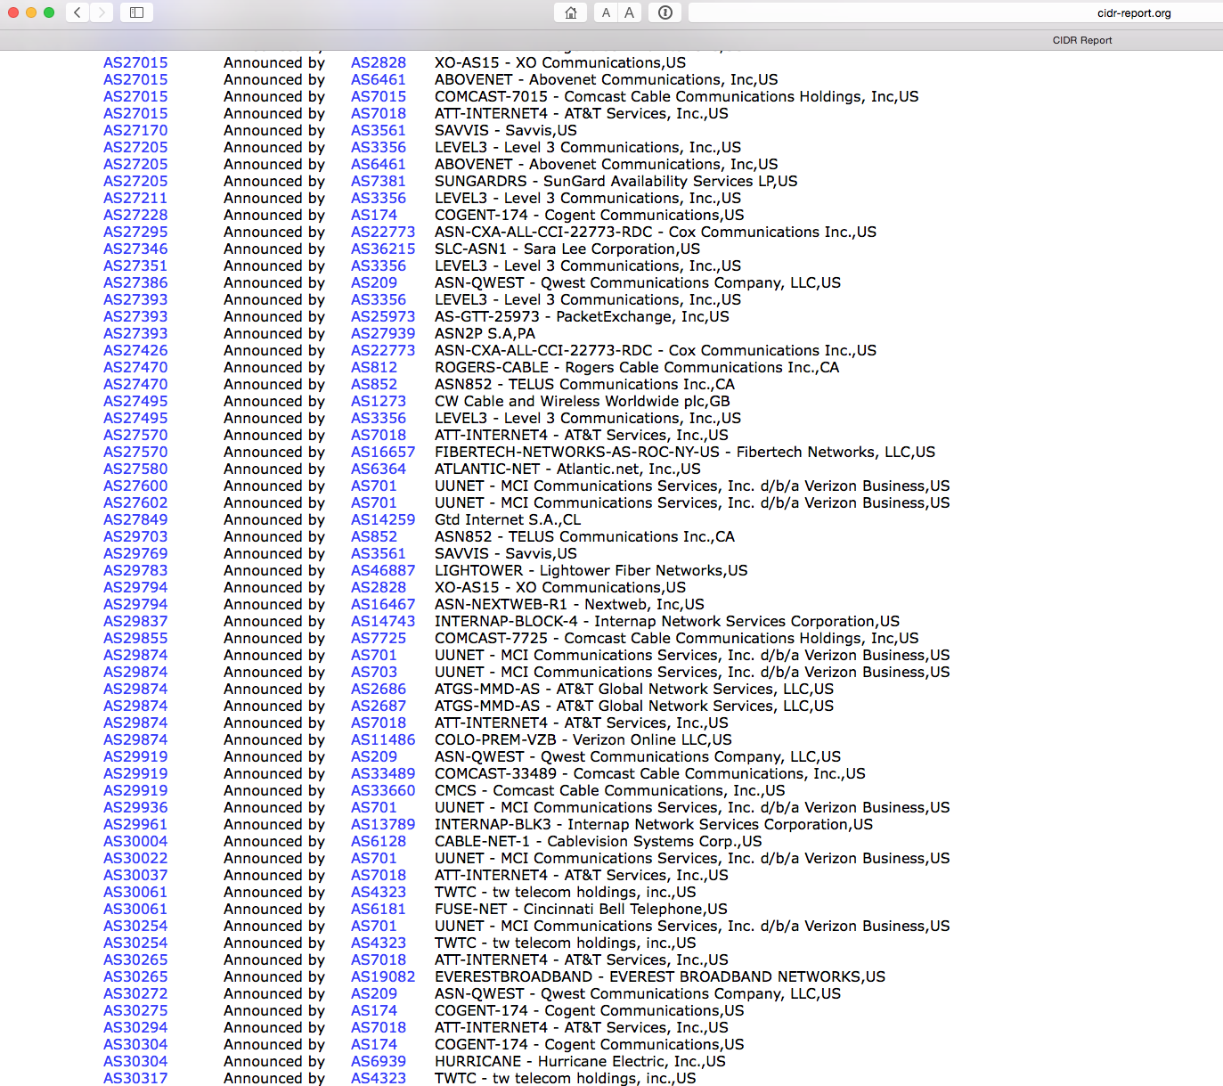
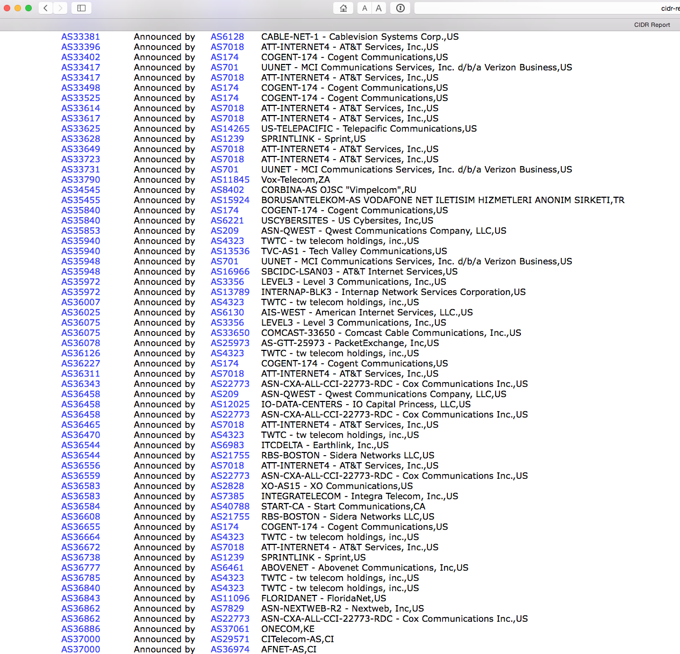
don’t forget: ALL of these advertised addresses and ASes are bogus!

Slide 21
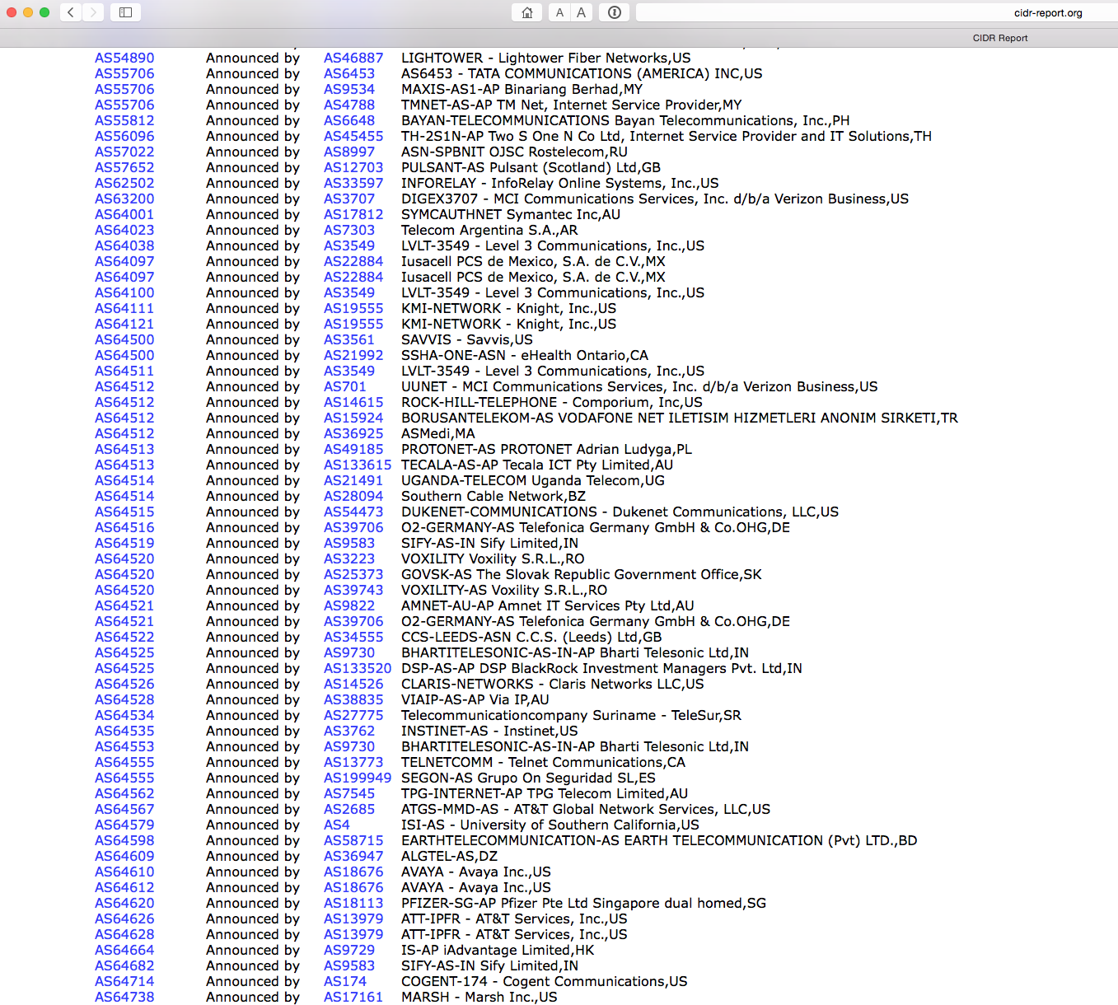
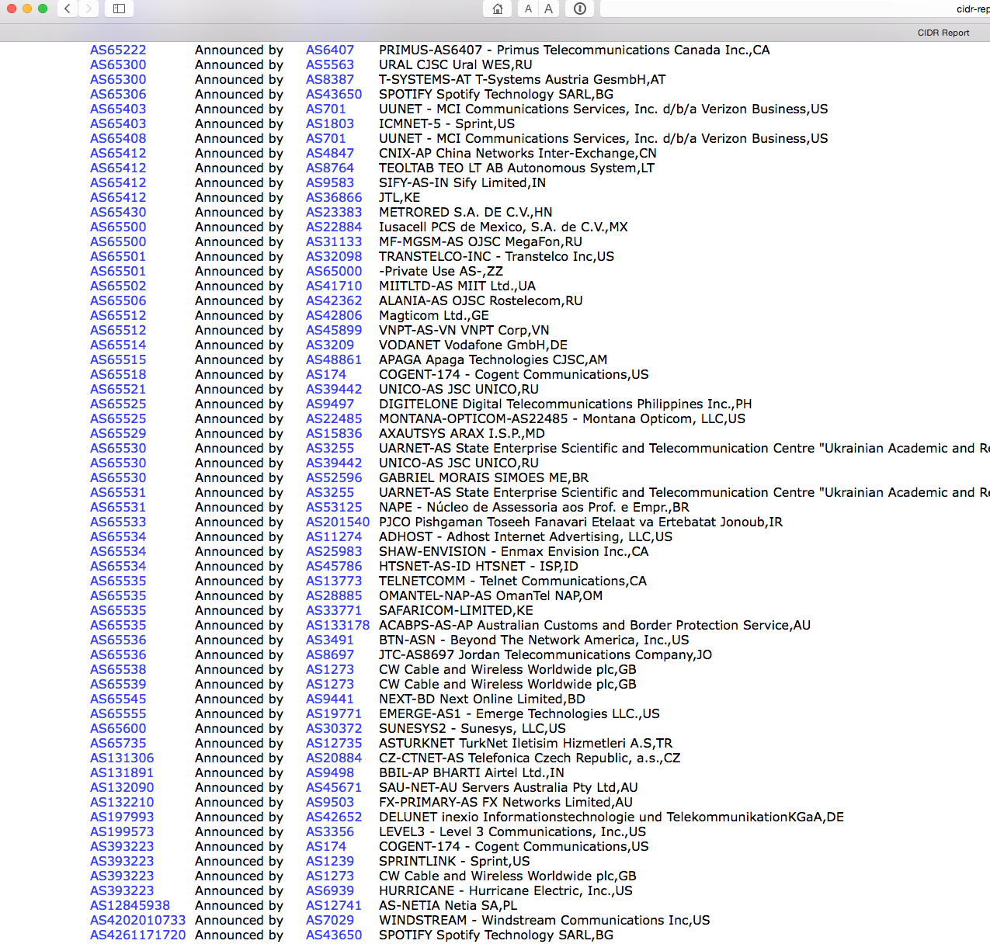
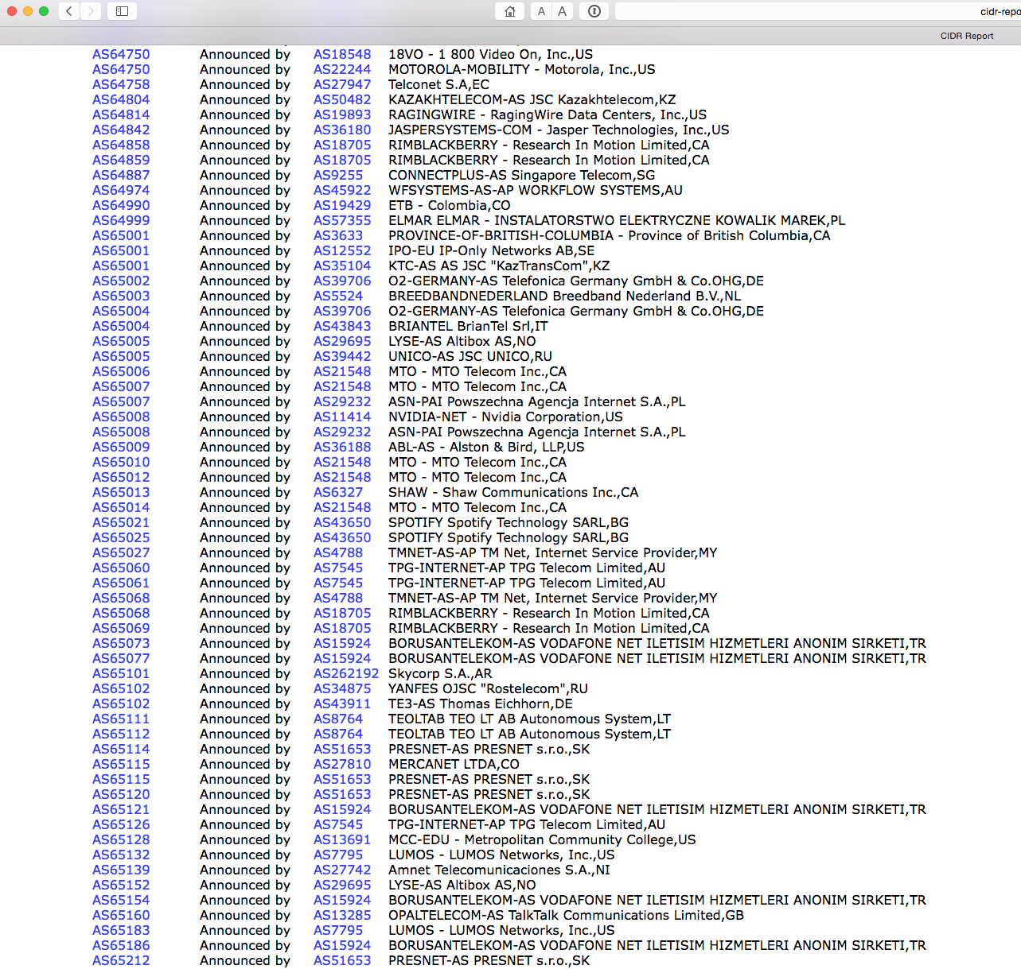
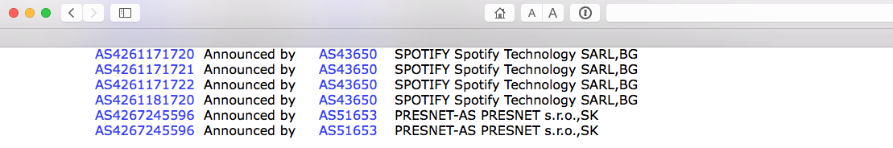
almost done…

Slide 22
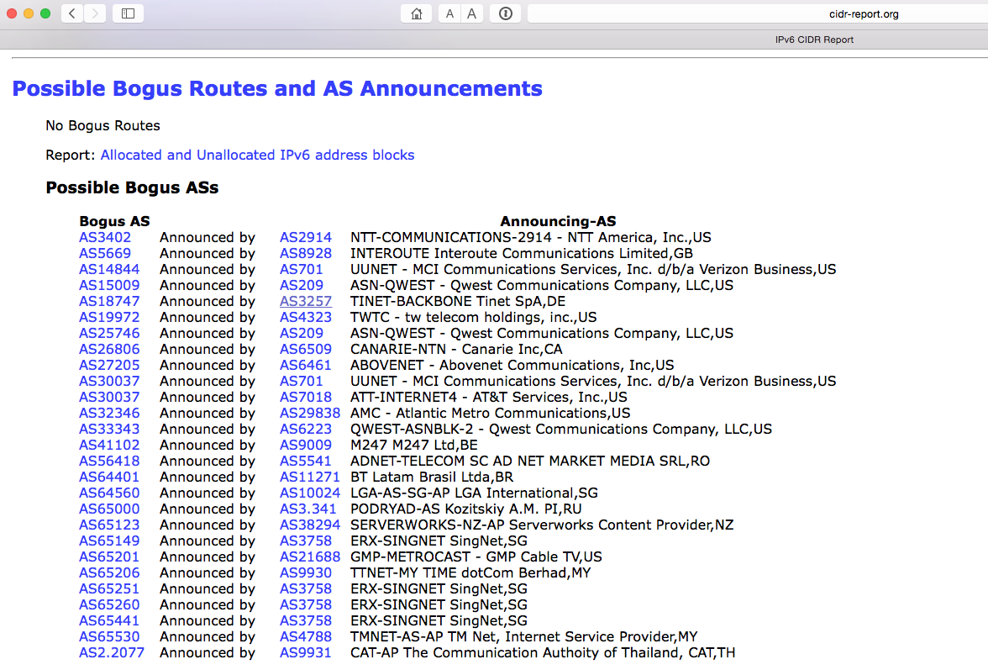
and lets not forget IPv6!

Slide 23
What’s the base problem here?
We are not doing a very good job
Routing is built on vague mutual trust models
Routing auditing is a low value activity that noone really performs with any level of thoroughness
We have grown used to lousy solutions and institutionalized lying in the routing system
And because instances of abuse are supposedly relatively infrequent we are prepared to tolerate the risk of having a completely insecure routing system

Slide 24
What’s the base problem here?
Noone seems to want to care enough about the integrity of the network to address routing integrity!

Slide 25
Routing Security is a shared problem
It’s a tragedy of the commons situation
  Nobody can single-handedly apply rigorous tests on the routing system
  And the lowest common denominator approach is to apply no integrity tests at all
  It’s all misplaced trust and absolutely no effective defence!

Slide 26
What SHOULD we be doing?

Slide 27

Routing Security A01
1. Protecting the routers
  Threat model:
    Compromised router used to insert corrupted address information into your network’s routing tables
    Insert corrupt reachability information into your network’s forwarding tables
    Allow the routing protocol to disseminate the corrupted information across the entire internet
  Response:
    Secure your routers!

Slide 28
Routing Security A01
1. Protecting the routers
  Threat model:
    Compromised router used to insert corrupted address information into your network’s routing tables
    Insert corrupt reachability information into your network’s forwarding tables
    Allow the routing protocol to disseminate the corrupted information across the entire internet
  Response:
    Secure your routers!
This is up to you, and the tools and operational practices are widely disseminated to achieve this – it’s not rocket science!

Slide 29
Routing Security A02
2. Protecting routing protocols and their operation
  Threat model:
    Disrupt the operation of the routing protocol by a “man-in-the-middle” attack
    Compromise the topology discovery / reachability operation of the routing protocol by injection of false routing information
  Response:
    Current operational best practice uses TCP-MD5 and avoids multihop for all eBGP sessions
MITM
Inject: 10.0.1.0/24
eBGP multihop session in the clear

Slide 30
Routing Security A02
2. Protecting routing protocols and their operation
  Threat model:
    Disrupt the operation of the routing protocol by a “man-in-the-middle” attack
    Compromise the topology discovery / reachability operation of the routing protocol by injection of false routing information
  Response:
    Current operational best practice uses TCP-MD5 and avoids multihop for all eBGP sessions
This is up to you and your eBGP peers, and the tools and operational practices are widely disseminated to achieve this – again, it’s not rocket science!
MITM
Inject: 10.0.1.0/24
eBGP multihop session in the clear

Slide 31
Routing Security A03
3. Protecting the routing protocol payload
  Threat model:
    Insert corrupted address information into your network’s routing tables
    Insert corrupt reachability information into your network’s forwarding tables
    Allow the routing protocol to disseminate the corrupted information across the entire internet
  Response:
AS 666
Routing attack on
10.0.1.0/24
10.0.1.0/24 (1,666) NO EXPORT
AS 3
AS 4
10.0.0.0/8 (1,2,3)
10.0.0.0/16 (1,2,3,4)

Slide 32
Routing Security A03
3. Protecting the routing protocol payload
  Threat model:
    Insert corrupted address information into your network’s routing tables
    Insert corrupt reachability information into your network’s forwarding tables
    Allow the routing protocol to disseminate the corrupted information across the entire internet
  Response:
Unfortunately, this could well be rocket science!
AS 666
Routing attack on
10.0.1.0/24
10.0.1.0/24 (1,666) NO EXPORT
AS 3
AS 4
10.0.0.0/8 (1,2,3)
10.0.0.0/16 (1,2,3,4)

Slide 33
Can we “tweak” BGP so that it can detect the difference between good and evil, and only advertise and propagate the “good” routes?

Slide 34
Routing Security
The basic routing payload security questions that need to be answered are:
  Who injected this address prefix into the network?
  Did they have the necessary credentials to inject this address prefix? Is this a valid address prefix?
  Is the forwarding path to reach this address prefix trustable?
And can these questions be answered by any BGP speaker quickly and cheaply?

Slide 35
A (random) BGP Update
2015/01/26 00:03:35 rcvd UPDATE w/ attr:
nexthop 203.119.76.3, origin i, path 4608 1221 4637 3561 3356 4657 4773
124.197.64.0/19

Slide 36
BGP Update Validation
2015/01/26 00:03:35 rcvd UPDATE w/ attr:
nexthop 203.119.76.3, origin i, path 4608 1221 4637 3561 3356 4657 4773
124.197.64.0/19
Is 124.197.64.0/19 a “valid” prefix?

Slide 37
BGP Update Validation
2015/01/26 00:03:35 rcvd UPDATE w/ attr:
nexthop 203.119.76.3, origin i, path 4608 1221 4637 3561 3356 4657 4773
124.197.64.0/19
Is 124.197.64.0/19 a “valid” prefix?
Is AS4773 a “valid” ASN?

Slide 38
BGP Update Validation
2015/01/26 00:03:35 rcvd UPDATE w/ attr:
nexthop 203.119.76.3, origin i, path 4608 1221 4637 3561 3356 4657 4773
124.197.64.0/19
Is 124.197.64.0/19 a “valid” prefix?
Is AS4773 a “valid” ASN?
Is 4773 an “authorized” AS that is permitted to advertise a route to this prefix?

Slide 39
BGP Update Validation
2015/01/26 00:03:35 rcvd UPDATE w/ attr:
nexthop 203.119.76.3, origin i, path 4608 1221 4637 3561 3356 4657 4773
124.197.64.0/19
Is 124.197.64.0/19 a “valid” prefix?
Is AS4773 a “valid” ASN?
Is 4773 an “authorized” AS that is permitted to advertise a route to this prefix?
Is the AS Path “valid”?
  Is AS 4657 a valid AS, and did AS 4773 advertise this route to AS 4657?
  Is AS 3356 a valid AS, and did AS 4657 advertise this route to AS 3356?
  Etc
Does this AS Path represent a viable forwarding path to reach this address prefix?

Slide 40
The Basics of Update Validation
The VALIDITY of the Address and AS number
The AUTHORISATION provided by the address holder to permit the AS to originate the route
The CORRECTNESS of the path to reach the destination

Slide 41
Approaches to Validity
The awesome power of Whois!
Entries in a routing registry
Delegation of reverse DNS zone
Certification of an allocation registry entry

Slide 42
Approaches to Validity
The awesome power of Whois!
Entries in a routing registry
Delegation of reverse DNS zone
Certification of an allocation registry entry
All of these approaches rely on some form of trusted third party attestation to provide information about the address
The credentials of the party holding the address are not well described in the first two approaches
For reverse DNS it’s the delegated zone admin
For certification it’s the holder of the private key

Slide 43
None of these Approaches are a Perfect Fit
Route Registries:
The route registry model relies on the maintenance of a trustable registry write access model. Too often this access model becomes a Mail From access or user / password. Efforts to move to keyed access and user certs have often foundered on user resistance to cert management tools in user systems
There is no single IRR, but many IRRs each with partial (and sometimes conflicting data) or dubious quality and uncertain validity
The Route Registry Object access model is variously implemented
All this can be improved, but to do so probably requires keys (and certs) and signed objects
In theory, and practice, this can work for a diligent, mutually trusting community using simple origination registry objects
If you operate a network high in the interconnection hierarchy, then the large ACL filters pose a scaling issue in terms of router config / state bloat
The operating overhead of maintaining current accurate data is high and the integrity of the route registry contents is vulnerable to bad actors

Slide 44
None of these Approaches are a Perfect Fit
Populating Reverse DNS:
The reverse DNS model does not cleanly map across CIDR delegations
  It can be coerced to do so, but its not a smooth fit
The approach relies on integrity of zone delegation and management
Mapping AS numbers?
  How can you answer “assemble the list of all addresses originated by an AS” if all you have in the reverse DNS is address -> AS mapping
Integrity of critical information in the DNS really needs DNSSEC
  Which in turn implies private key management tools and practices on the part of address holders
Would this approach be a case of overloading the DNS?

Slide 45
None of these Approaches are a Perfect Fit
Number PKI:
A PKI for Addresses and AS numbers has issues has its own issues
Key / Cert management for a new PKI requires a dedicated tool set
Familiarity with managing keys is an issue
Hardware and software tools for use in this PKI tend to be incomplete and expose much of the underlying mechanics of the crypto system
Acceptance by operators is an issue
Distribution of Certificates and CRLs uses “just in case” flooding and runs into a novel set of issues of distribution and synchronization of routing information and the associated credentials that need to be used to validate the routing information

Slide 46
A Foundation for Routing Security
  A PKI for addresses and ASNs makes a lot of sense: (*)
    Use digital signatures to both the integrity, the authenticity and the currency of the signed data. This allows systems to automatically validate attestations about addresses and their use
    Digital signatures that can be validated in this PKI can be used to sign:
      Route Registry Entries
      Route Requests
      BGP
* Yes, that’s a personal opinion!

Slide 47
What about BGP?
What are the trade-offs in adding any of these approaches into the context of BGP?
  How a BGP speaker can be assured that the origination of the route is valid?
  And that the AS path that is being presented is an authentic representation of a viable forwarding path to the address?

Slide 48
BGP Elements
Origination
  Is the address valid?
  Is the origination of this route a duly authorized use of this address?
Path
  Is the forwarding path represented in the route an authentic path?
  If I pass a packet into this path will it get to its intended destination?

Slide 49
BGP Origination (1)
Managed Filters
  Filter lookup is fast within the router, and filter construction can be undertaken by a trusted off-unit subsystem, using an incremental difference sync protocol to keep the router state in sync
  Route Registry model of declaring in advance what addresses you may advertise to your BGP peers
    The peer constructs an acceptance filter based on this list
  RPKI ROA model of declaring in advance what addresses you may advertise to your BGP peers
    The peer constructs an acceptance filter based on this list

Slide 50

A filter-based architecture for securing BGP origination
eBGP
Router
Local Route
Policy Engine
BGP Filter
(Origin AS +
prefix mask)
Distribution /
Synchronisation
Route Origination Information
(Route Registries or RPKI certs and ROAS)

Slide 51
BGP Origination (2)
Update Filtering
  Update filtering allows the credential information to be passed with the data, allowing for “just in time” delivery of credentials and information
  Can be undertaken on-board, or outsourced to update filtering BGP route server(s) within each AS
  RKPI ROA attached to the update as an opaque transitive attribute?
    BGP bloat?
    Digital signatures plus PKI Certs can add significant size to updates and processing load to routers (as in a BGP peer session reset)
  Or perform a Reverse DNS lookup
    Validate originating AS through a DNS query of the prefix

Slide 52
A update-based architecture for securing BGP origination
Address
Y/N
Origin AS
AS Path
eBGP
Router
Origination
Credentials
Local Validation
Function
Address
BGP
Update
Origin AS
Origination
Credentials
+
Local Trust Material

Slide 53
Path Validation
Origination validation reduces the attack surface, but an attacker can still inject bogus routes as long as it synthesizes the specified originating AS in the bogus route entry
So while origination protection is a good initial step, it is just an initial step and by itself its not a completely adequate approach to routing security
But how far (and at what cost) should we go to secure AS Paths?

Slide 54
option a:
Route Registries and RPSL
Using RPSL and various forms of export and import attestations in a route registry it is feasible to construct AS Path filters that allow a BGP speaker to filter out implausible AS Paths from incoming updates
In practice RPSL never gained widespread acceptance. Some communities worked hard to promulgate its use, but overall it was unable to achieve widespread adoption and the effort / benefit equation was unsustainable
RPSL path filters can filter out what’s implausible

Slide 55
option b:
AS Adjacency and soBGP
A similar approach was described in soBGP, where a pair of adjacent ASs would publish and propagate a signed AS Adjacency Attestation
If a BGP speaker receives a AS Path it can break the path into a sequence of AS adjacency pairs and determine if the AS Path represents a plausible transit path through the network
This plausibility test can be performed through a filter operation performed on received updates, either on-board or off-loaded

Slide 56
option c:
AS Path Validation and BGPsec
BGPsec proposes a stricter form of AS Path validation where each eBGP speaker uses its own digital key to sign across the path and the AS to whom the update is being sent
It is not possible for a third party to construct a bogus route in this scenario unless it gains access to keys
But this sequence of interlocking signatures implies:
  BGPsec routers are required to unchain the signature set and match it to the AS Path in the update, using the local RPKI cache to validate the router signatures
  BGP bloat in carrying interlocking signatures
  a high crypto processing overhead in processing updates
  no useful validation in cases of piecemeal adoption of BGPsec

Slide 57
Concerns
A major issue here is that of partial use and deployment
  This security mechanism has to cope with partial deployment in the routing system
    The basic conventional approach of “what is not certified and proved as good must be bad” will not work in a partial deployment scenario
  In BGP we need to think about both origination and the AS Path of a route object in a partial deployed environment
    AS path validation is challenging indeed in an environment of piecemeal use of secure credentials, as the mechanism cannot tunnel from one BGPsec “island” to the next “island”
  A partially secured environment may incur a combination of high incremental cost with only marginal net benefit to those deploying BGPsec

Slide 58
Concerns
Is a trust hierarchy the best approach to use?
  The concern here is concentration of vulnerability
    If validation of routing information is dependent on the availability and validity of a single root trust anchor then what happens when this single digital artifact is attacked?
  But is there a viable alternative approach?
    Can you successfully incorporate robust diversity of authentication of security credentials into a supposedly highly resilient secure trust framework?
This is a very challenging question about the nature of trust in a diverse networked environment!

Slide 59
Concerns
Is certification the only way to achieve useful outcomes in securing routing?
  Is this form of augmentation to BGP to enforce “protocol payload correctness” over-engineered, and does it rely on impractical models of universal adoption?
  Can various forms of routing anomaly detectors adequately detect the most prevalent forms of typos and deliberate lies in routing with a far lower overhead, and allow for unilateral detection of routing anomalies?
  Or are such anomaly detectors yet another instance of “cheap security pantomime” that offer a thinly veiled placebo of apparent security that is easily circumvented or fooled by determined malicious attack?

Slide 60
What are we trying to do?
Is securing the routing system alone actually enough?
  Can you validate the “correctness” of the forwarding paths being proposed by a routing system?
    Is secure routing helpful in and of itself?
    Or this this just pushing the vulnerability set to a different point in the network integrity space?
    Does this adequately reduce the level of exposure to attack?
    Is BGP too incomplete in terms of its information distribution properties to allow robust validation of the intended forwarding state?
If not, then is this a case of too high a cost or too low a benefit?
  Is this a case of reducing the security credential generation and validation workload by reducing the security outcomes through reduced trust and/or reduced amount of validated information
  Or is this a case of increasing the level of assurance and the amount of routing information secured by these mechanisms

Slide 61
What are we trying to do?
Is Partial Deployment of any value?
  Are the semantics of routing security and incomplete credentials compatible concepts?
    Can you deploy high integrity security using partial deployment scenarios?
    The issue here is that credentials can assure a recipient that the information that they receive are authentic. They can mark what’s “good”. But the aim of the exercise is to identify what’s “bad”.
    In a scenario of comprehensive deployment, then the inability to determine “good” implies “bad”
    In partial deployment scenarios the inability to determine “good” means…?

Slide 62
Good, Fast, or Cheap?
Pick one!
We just can’t make secure routing mechanisms cheaper, faster, more robust, and more effective than existing routing tools …
  We can make it robust, but it won’t be cheap, and probably not fast!
  We can make it fast, but it won’t be robust and it won’t be cheap!
  We can make it cheap, but it won’t be completely robust!

Slide 63
Good, Fast, or Cheap?
Pick one!
We just can’t make secure routing mechanisms cheaper, faster, more robust, and more effective than existing routing tools …
  We can make it robust, but it won’t be cheap, and probably not fast!
  We can make it fast, but it won’t be robust and it won’t be cheap!
  We can make it cheap, but it won’t be completely robust!
So where should we compromise in the design of a secure routing infrastructure?

Slide 64
Caution: Opinions!
My personal view of design compromise:
  Improve the robustness of RPKI certs by altering the cert validation algorithm
  Place origination signatures, ROAs and certs into the BGP protocol updates as opaque attributes
  Use AS Adjacency attestations in preference to a fully signed path
  Place AS Adjacency attestations into BGP protocol updates as opaque attributes
  Exploit the use of TCP in BGP to never resend already sent certs
  Flatten parts of the CA hierarchy by using RAs rather than CA delegations
  Reduce OOB credential distribution to TA material
    For which you can use the DNS and DNSSEC if you really want!
  Like all the other approaches, this represents a particular set of compromises about speed, complexity, cost, deployment characteristics and robustness – it has it’s weaknesses in terms of comprehensive robustness, but it attempts to reduce the number of distinct moving parts

Slide 65
Thank You
Questions?

