Slide 1
Yet Another Talk on IPv6
Geoff Huston
APNIC

Slide 2
This is getting harder, not easier...
Talks about IPv6 appear to have explored every aspect of IPv6 from technology to potential applications
Which makes the task of saying something new and (hopefully) interesting about IPv6 harder and harder!

Slide 3
What can I tell you...
that contains some hopefully useful insights into IPv6,
that might help in explaining how our industry works and why things are the way they are,
and
that you have not heard before!

Slide 4
IPv6 as a Technology
IPv6 was deliberately positioned as a conservative set of evolutionary technology changes to IPv4
  + larger address fields
  + structured header options
  +/- altered packet fragmentation behaviour
  +/- multicast router configuration
  multi-addresses and address scope
  embedded Interface Identifier
  ? the flow label

Slide 5
IPv6 as a Technology
So what changed from IPv4?
  Not much:
  Fragmentation control has been altered
  Address resolution behaviour has been altered
  And the address fields are bigger!

Slide 6
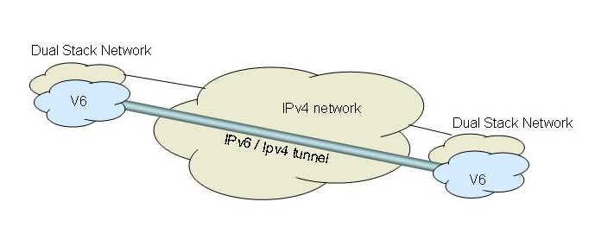
IPv6 as a Transition
A plan that is under constant revision!
  Originally we had hoped for hoped a piecemeal transition with fully functional backward compatibility
  Then we came up with a Dual Stack transition with parallel coexistence with IPv4
    Relying on auto-tunneling of IPv6 over IPv4 for the initial phases of the transition

Slide 7
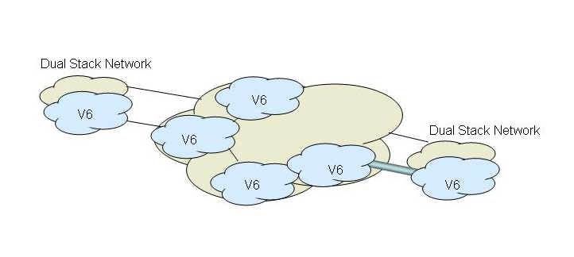
IPv6 as a Transition
A plan that is under constant revision!
  Originally we had hoped for hoped a piecemeal transition with fully functional backward compatibility
  Then we came up with a Dual Stack transition with parallel coexistence with IPv4
    Relying on auto-tunneling of IPv6 over IPv4 for the initial phases of the transition

Slide 8
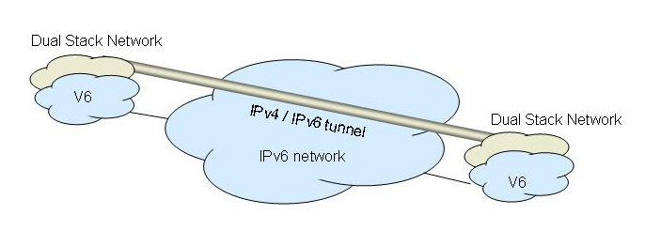
IPv6 as a Transition
A plan that is under constant revision!
  Originally we had hoped for hoped a piecemeal transition with fully functional backward compatibility
  Then we came up with a Dual Stack transition with parallel coexistence with IPv4
    Relying on auto-tunneling of IPv6 over IPv4 for the initial phases of the transition

Slide 9
IPv6 as a Transition
We have to rethink this plan:
  Now we are faced with a Dual Stack transition that includes:
    No auto-tunneling of IPv6 over IPv4
    Mandatory address extension mechanisms in IPv4
    Maintaining the current profile and behaviours of the network platform through the transition
  This has not been clearly thought through, and is a highly risky process in terms of service robustness

Slide 10
IPv6 Marketing
So far we have yet to find the “magic bullet” that gives IPv6 a clear marketing edge
  It’s not faster
  It’s not cheaper
  It’s not better
  It could be more secure, but we undervalue security!
  There are no clear discriminants in terms of delivered services to users

Slide 11
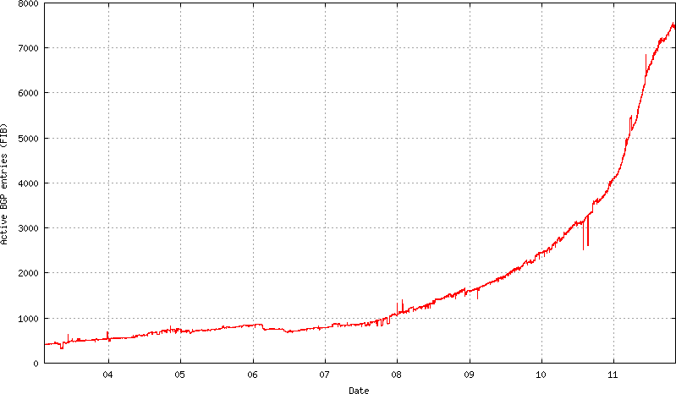
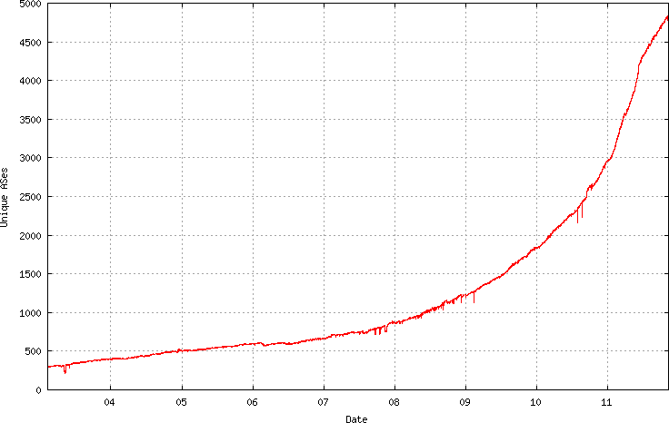
IPv6 Deployment Metrics
Routing Table Entries
AS Count

Slide 12
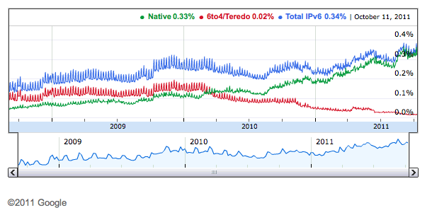
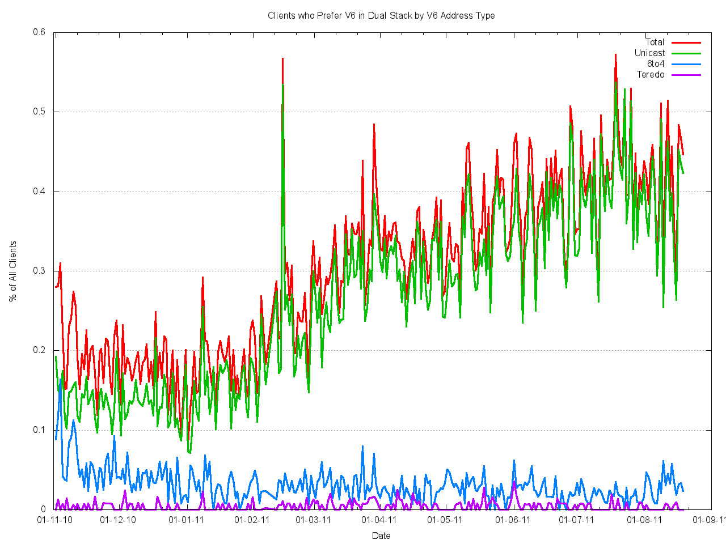
IPv6 Deployment Metrics
APNIC Measurements
http://www.google.com/intl/en/ipv6/statistics/

Slide 13
IPv6 Deployment Measurements
It’s a mixed picture:
  Some 40% of the Internet’s transit networks appear to be dual stack capable
  Some 50% of the Internet’s end devices have an installed and active IPv6 stack
  Around 0.4% of the Internet’s end devices have the combination of a local IPv6 protocol stack, and a coupled carriage access service that delivers IPv6 to the device

Slide 14
Where to from here?

Slide 15
IPv4 Address Exhaustion
IPv6 was meant to be the “answer” to IPv4 address exhaustion
  And the intention from the technology folk was that the industry should’ve completed the transition before we reached the point of exhaustion in IPv4 supply
  Obviously this has not happened
  IPv6-only network deployments are not viable today
  And continuing IPv4 network expansion calls for deployment of novel address extension mechanisms that diverts attention and resources from IPv6 deployment

Slide 16
It’s not looking good for IPv6

Slide 17
But failure should not be an option
We simply cannot give up on IPv6
  We cannot sustain a single coherent open network platform in IPv4
  End-to-End coherency is lost in a plethora of conflicting middleware handlers
  We lose openness and competition in the network
    Innovation turns from being a permissionless exercise to one that has prohibitive barriers to entry
    Carriage incumbency shifts to Monopoly Control
    And the economic benefits that flow from a vibrant innovative and open communications sector grind to a halt

Slide 18
How can we fix this?
Or will this situation correct itself?
  Will IPv4 address exhaustion provide impetus for access carriage providers to turn to IPv6?
  Will we see 3G and 4GLTE mobile environments turn to IPv6 to fuel continued growth in the mobile service environment?

Slide 19
How can we fix this?
Or is this the first stages of a large scale market failure of the transition function?
  In which case the market will continue to distort, leading to emergence of new cartels and monopolies
  Unless there is some very finely crafted form of public intervention into the market

Slide 20
How can we fix this?
Should there be regulatory intervention?
  What form could such an intervention take?
  Would it impose further costs on end users?
  And how can we ensure that the “cure” is not worse that the problem we are trying to fix?

Slide 21
More difficult questions
Are these even the “right” questions?
There are many other strategic issues in today’s Internet:
  International geopolitics and the ongoing issues with legacy treaty structures and divergent national agendas for public communications services
  Ongoing IPR intervention and the evident desire by the IPR sector to tear apart the principles of common carrier privilege, network neutrality and the open Internet itself
  What are we doing about (in)security and the risks to users, commerce and national security as we place more social functions and services on the network? The network itself is more virulent and toxic, as the attack capability overwhelms our limited capacity to defend the integrity of the network’s assets
Where does IPv6 transition fit in this larger world view of the Internet?

Slide 22
And I can’t answer them!

Slide 23
But I can hope...
It would be so good if these issues simply resolved themselves in positive ways:
  That access carriage providers were sufficiently motivated to deploy IPv6 services
  That we were able to insert an IPv6 service into the 3G and 4G radio systems and hand devices
  That a coherent clear end-to-end IPv6 platform materially supported robust end-to-end channel security and service platform security
  That we maintained an open network framework that supported continued innovation and vibrant competition

Slide 24
I am also a realist...
How will we know if and when we are failing?
If various forms of intervention are going to be called for, how can we ensure that we do so in time, and apply just the right level of intervention to the market structure?
Who really cares about the enduring interest of the consumers in the services delivered by the Internet industry?

Slide 25
Back to IPv6
It’s clear that the benefits we’ve enjoyed from the past couple of decades of the Internet have much to do with the basic coherent end-to-end architecture of IP
And it’s also clear that we’ve now stretched IPv4 beyond its capacity to deliver this architecture
And IPv6 is precisely all we have to fuel the Internet from this point onward
There really are no viable alternatives, and no more time for excuses and further prevarication by industry actors and regulators

Slide 26
Thank You!
Questions?

